Slide 1
Diffusion and Peer Influence

Slide 2
Diffusion & Peer Influence
“you are who you associate with”
Time

Slide 3
Diffusion
Compartmental Models
Network Diffusion
Topology
Timing
Structural Transmission
Complex contagion
Peer Influence

Slide 4
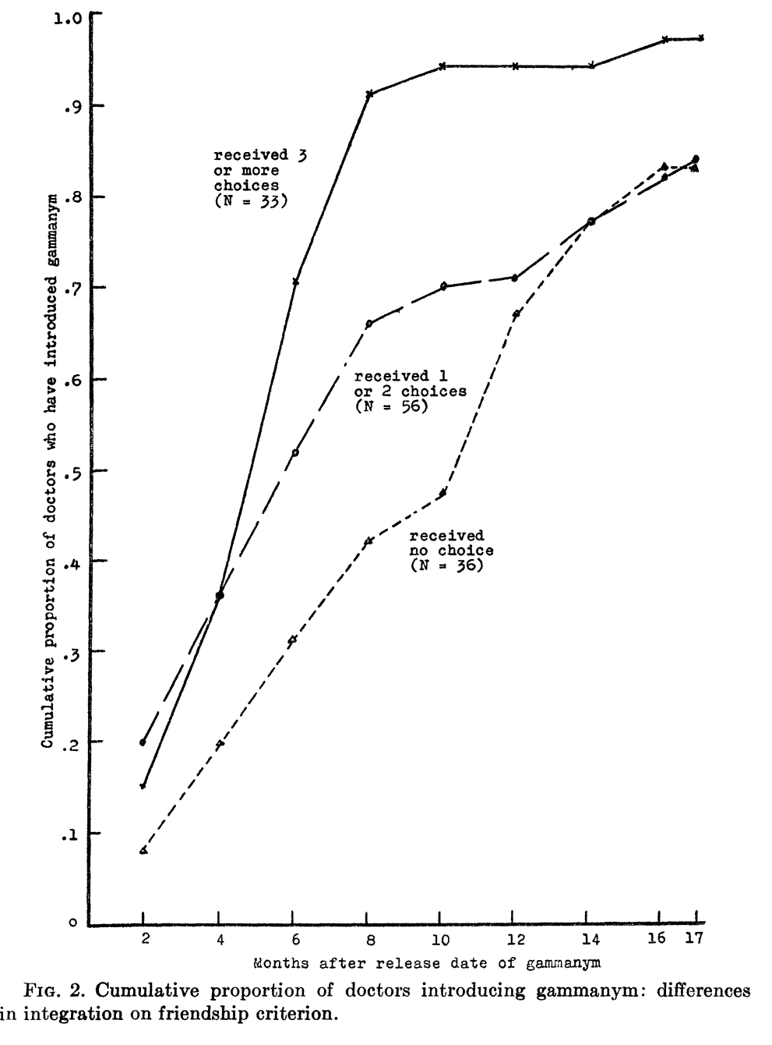
Network Diffusion & Peer Influence
Basics
Coleman, Katz and Menzel, “Diffusion of an innovation among physicians” Sociometry (1957)
Our substantive interest in networks is often in how things move through them, from disease to ideas to behavior.

Slide 5
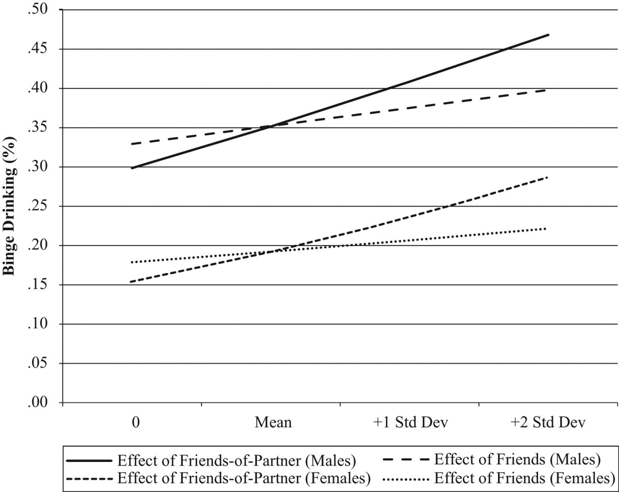
Network Diffusion & Peer Influence
Basics
Figure 2. Binge Drinking Predicted Probabilities by Gender and Friends’ Prior Drinking.
Romantic partnerships in high school lead to adoption of partners’ friends’ behaviors
Derek A. Kreager, and Dana L. Haynie American Sociological Review 2011;76:737-763
Notes:
Binge Drinking Predicted Probabilities by Gender and Friends’ Prior Drinking

Slide 6
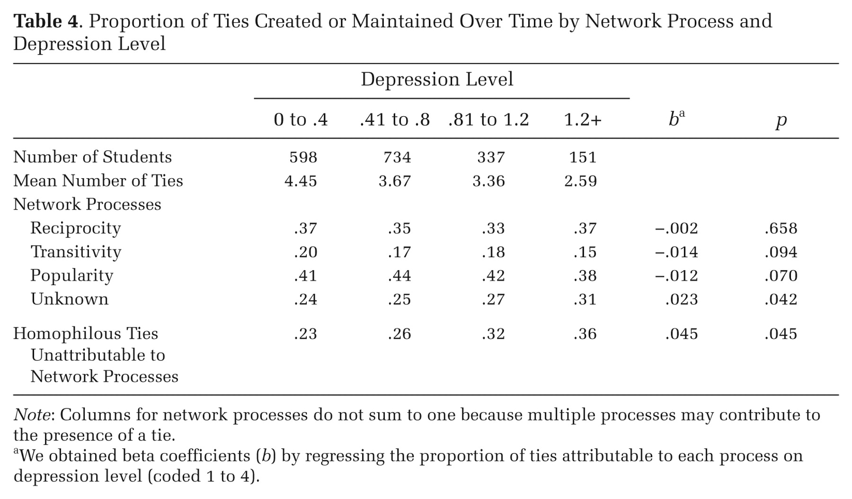
Health effects on ties
Depressed students form ties through non-normative network processes
Table 4. Proportion of Ties Created or Maintained Over Time by Network Process and Depression Level.
David R. Schaefer et al. American Sociological Review 2011;76:764-785
Notes:
Proportion of Ties Created or Maintained Over Time by Network Process and Depression Level

Slide 7
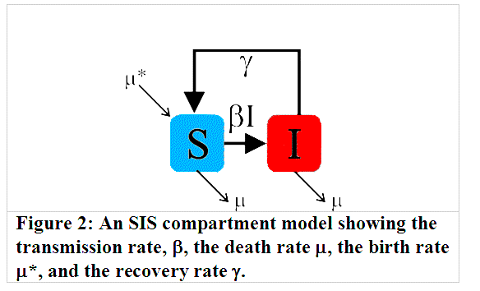
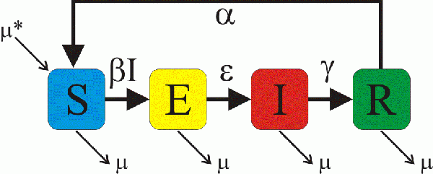
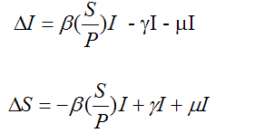
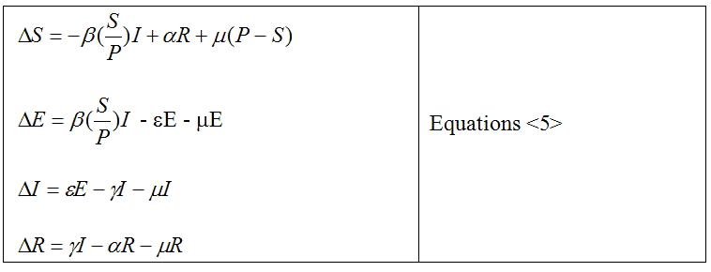
Network Diffusion & Peer Influence
Basics
Classic (disease) diffusion makes use of compartmental models. Large N and homogenous mixing allows one to express spread as generalized probability models.
Works very well for highly infectious bits in large populations…
SI(S) model – actors are in only two states, susceptible or infectious.
SIIR(S) model – adds an “exposed” but not infectious state and recovered.
See: https://wiki.eclipse.org/Introduction_to_Compartment_Models for general introduction.

Slide 8
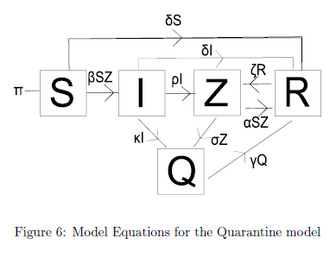
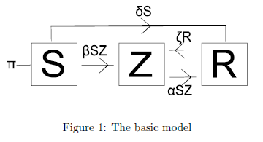
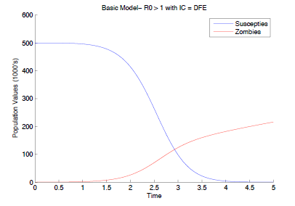
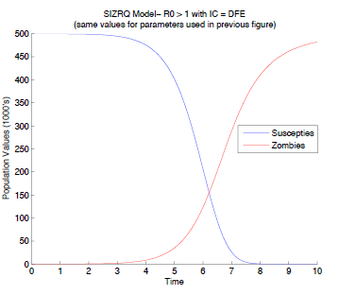
Network Diffusion & Peer Influence
Basics – might even help understand the zombie apocalypse
http://loe.org/images/content/091023/Zombie%20Publication.pdf

Slide 9
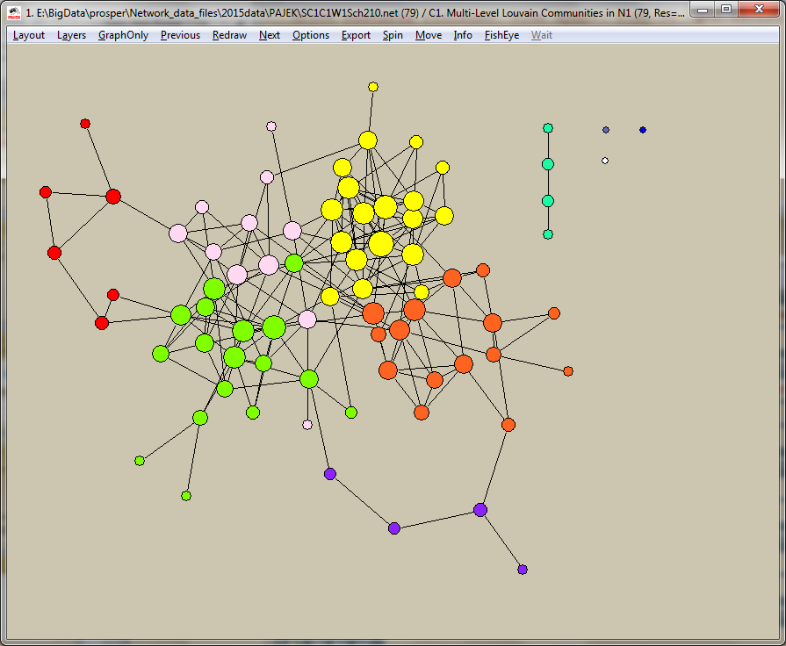
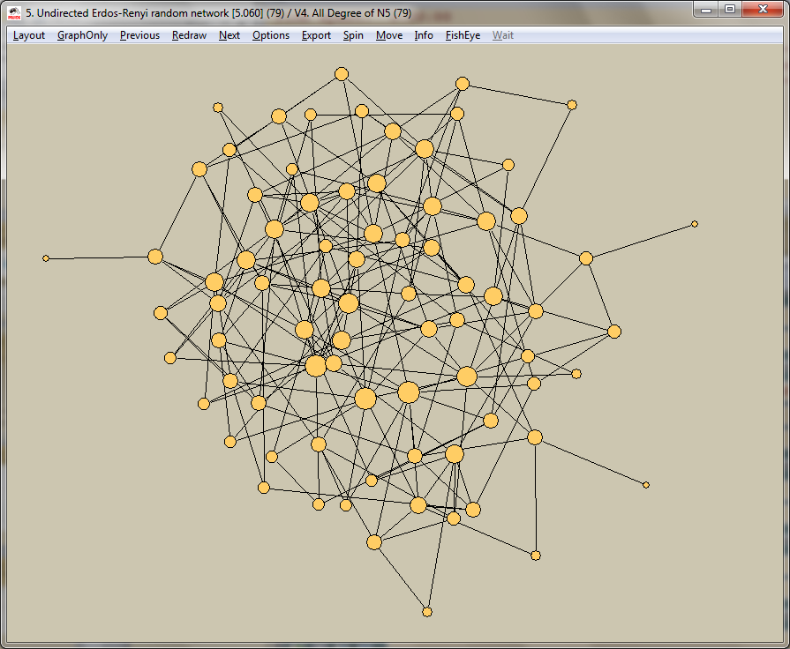
Network Diffusion & Peer Influence
Basics
Network Models
Same basic SI(R,Z,etc) setup, but connectivity is not assumed random, rather it is structured by the network contact pattern.
If p_{ij} is small or the network is very clustered, these two can yield very different diffusion patterns.*
Real
Random
*these conditions do matter. Compartmental models work surprisingly well if the network is large, dense or the bit highly infectiousness…because most networks have a bit of randomness in them. We are focusing on the elements that are unique/different for network as opposed to general diffusion.

Slide 10
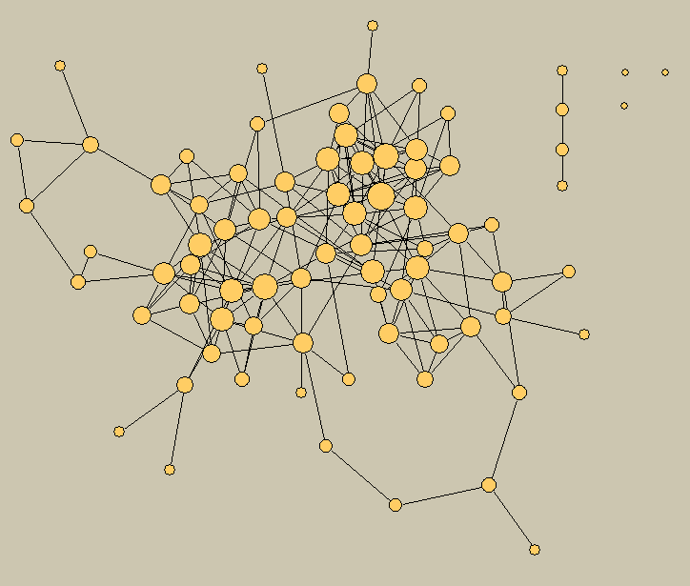
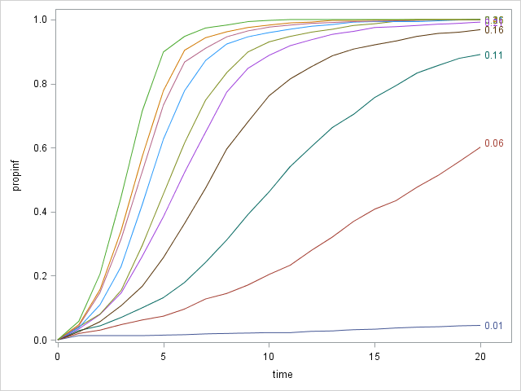
Network Diffusion & Peer Influence
Basics
If 0 < p_{ij} < 1

Slide 11
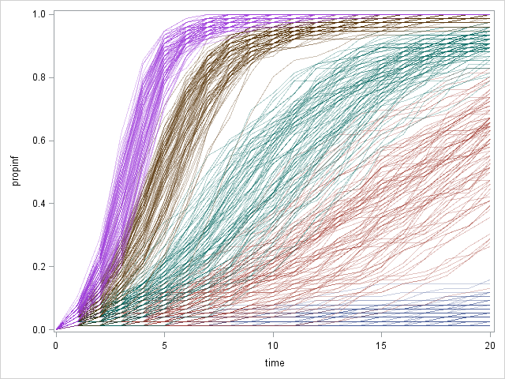
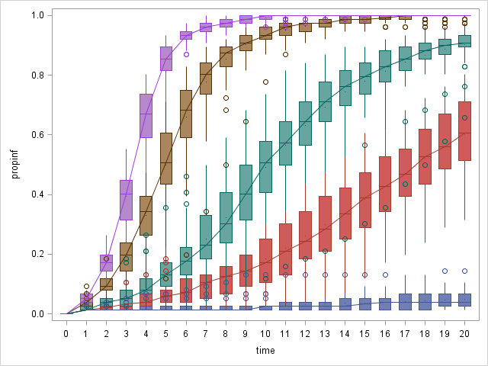
Network Diffusion & Peer Influence
Basics
If 0 < p_{ij} < 1
0.46
0.26
0.11
0.06
0.01

Slide 12
Network Diffusion & Peer Influence
Network diffusion features
Key Question: What features of a network contribute most to diffusion potential?
In addition to* the dyadic probability that one actor passes something to another (p_{ij}), two factors affect flow through a network:
Topology
the shape, or form, of the network
- Example: one actor cannot pass information to another unless they are either directly or indirectly connected
Time
- the timing of contact matters
- Example: an actor cannot pass information he has not receive yet
Use simulation tools to explore the relative effects of structural connectivity features
*This is a big conditional! – lots of work on how the dyadic transmission rate may differ across populations.

Slide 13
Network Diffusion & Peer Influence
Network diffusion features
We need:
(1) reachability
(2) distance
(3) local clustering
(4) multiple routes
(5) star spreaders
A network has to be connected for a bit to pass over it
If transmission is uncertain, the longer the distance the lower the likelihood of spread.
Distance and diffusion (p(transfer)=p_{ij}^{dist}
Here p_{ij} of 0.6
0.4
probability
0.2
0
2
3
4
5
6
Path distance
Notes:
Working through the mathematical requirements for the intuitive notion of ‘widely distributed’ ties, we come up with the following two equivalent definitions of structural cohesion
(read).

Slide 14
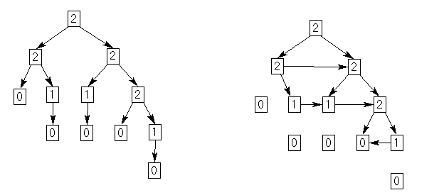
Network Diffusion & Peer Influence
Network diffusion features
We need:
(1) reachability
(2) distance
(3) local clustering
(4) multiple routes
(5) star spreaders
Local clustering turns flow “in” on a potential transmission tree
Arcs: 11
Largest component: 12,
Clustering: 0
Arcs: 11
Largest component: 8,
Clustering: 0.205
Notes:
Working through the mathematical requirements for the intuitive notion of ‘widely distributed’ ties, we come up with the following two equivalent definitions of structural cohesion
(read).

Slide 15
Network Diffusion & Peer Influence
Network diffusion features
We need:
(1) reachability
(2) distance
(3) local clustering
(4) multiple routes
(5) star spreaders
The more alternate routes one has for transmission, the more likely flow should be.
Operationalize alternate routes with structural cohesion
Notes:
Working through the mathematical requirements for the intuitive notion of ‘widely distributed’ ties, we come up with the following two equivalent definitions of structural cohesion
(read).

Slide 16
X
Y
C
Network Diffusion & Peer Influence
Network diffusion features
P
Probability of transfer
by distance and number of non-overlapping paths, assume a constant p_{ij} of 0.6
1.2
1
10 paths
Cohesion ➔ Redundancy ➔Diffusion
0.8
5 paths
probability
0.6
2 paths
0.4
1 path
0.2
0
2
3
4
5
6
Path distance

Slide 17
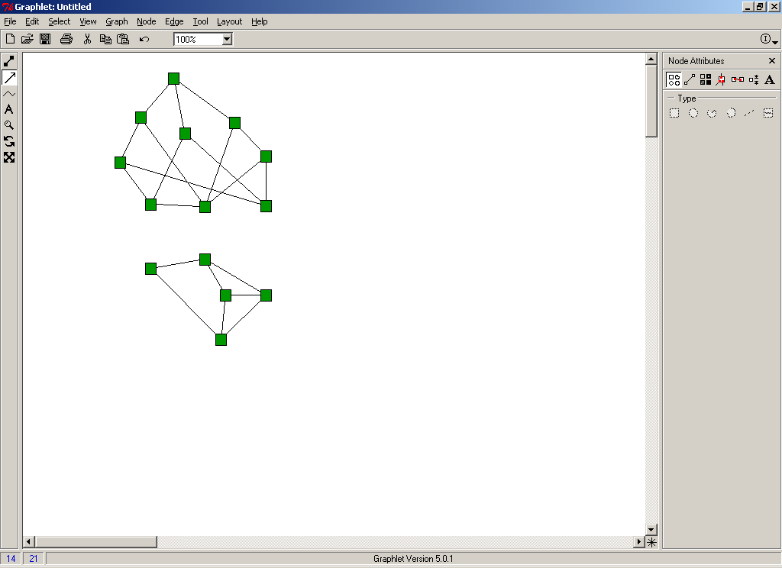
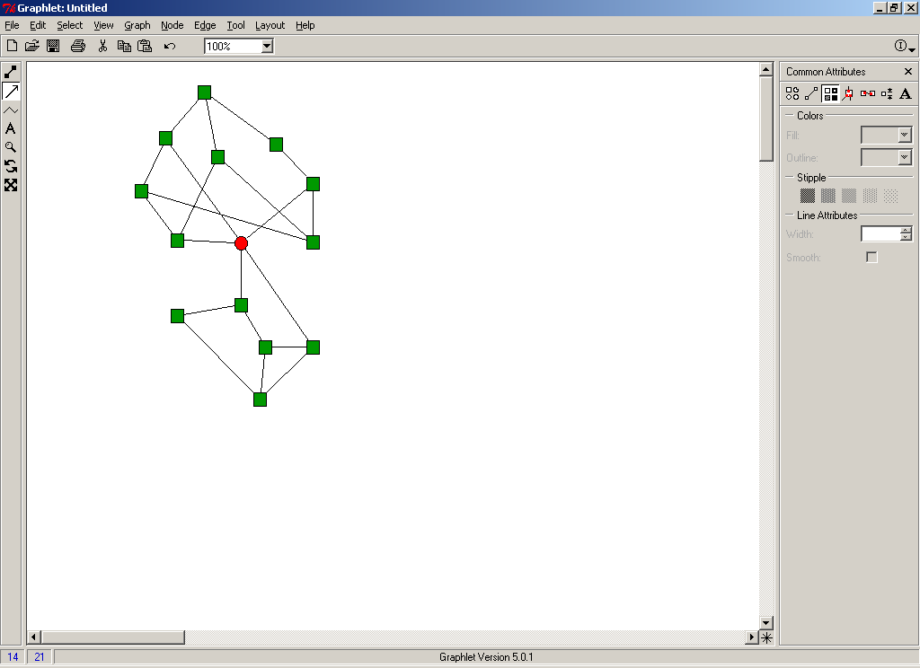
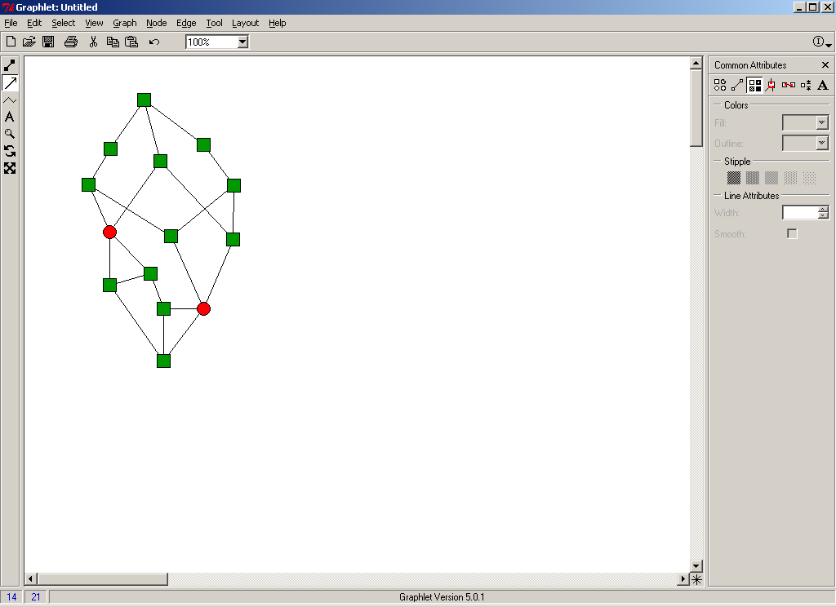
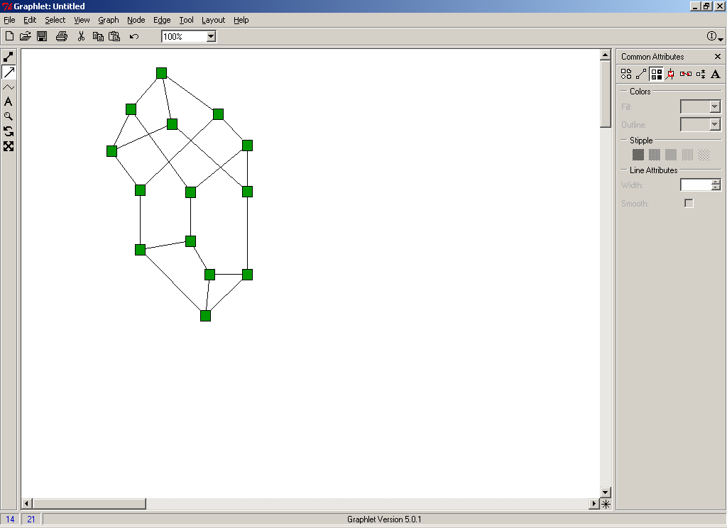
X
Y
C
Network Diffusion & Peer Influence
Network diffusion features
P
Structural Cohesion:
A network’s structural cohesion is equal to the minimum number of actors who, if removed from the network, would disconnect it.
0
1
2
3
Node Connectivity
As number of node-independent paths
Notes:
To illustrate, consider these four networks, each with an identical volume of social ties.
The graphs become more difficult to separate, and the number of independent paths increase. This is illustrated in the far left, where we can always trace at least 3 completely independent paths between every pair of people in the net.

Slide 18
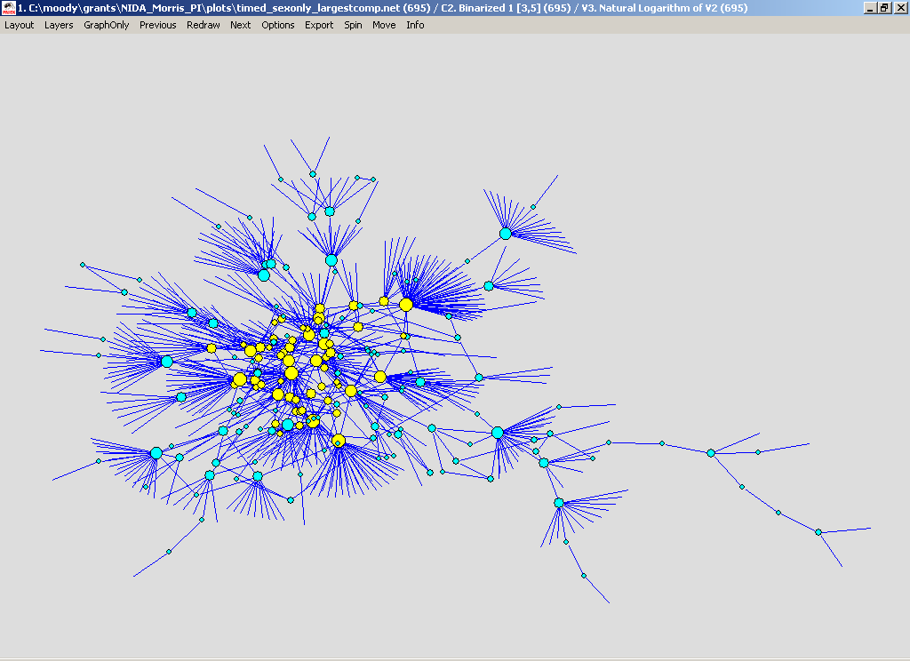
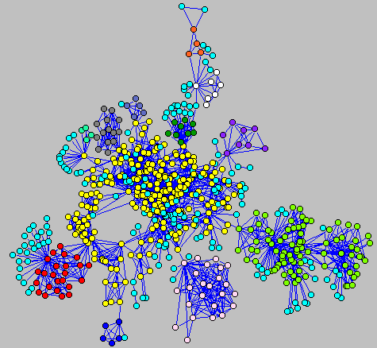
X
Y
C
Network Diffusion & Peer Influence
Network diffusion features
P
STD Transmission danger: sex or drugs?
Structural core more realistic than nominal core
Data from “Project 90,” of a high-risk population in Colorado Springs

Slide 19
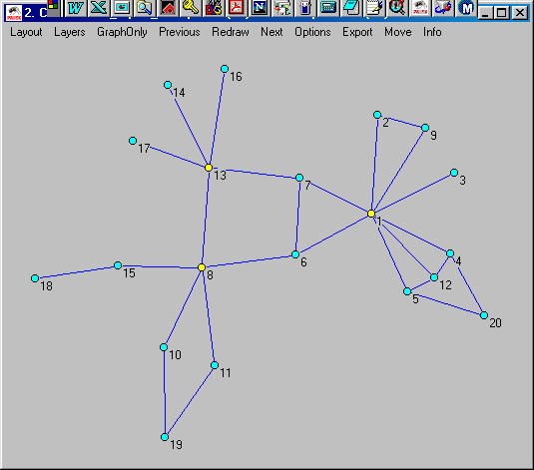
Network Diffusion & Peer Influence
Network diffusion features
We need:
(1) reachability
(2) distance
(3) local clustering
(4) multiple routes
(5) star spreaders
Much of the work on “core groups” or “at risk” populations focus on high-degree nodes. The assumption is that high-degree nodes are likely to contact lots of people.
Notes:
Working through the mathematical requirements for the intuitive notion of ‘widely distributed’ ties, we come up with the following two equivalent definitions of structural cohesion
(read).

Slide 20
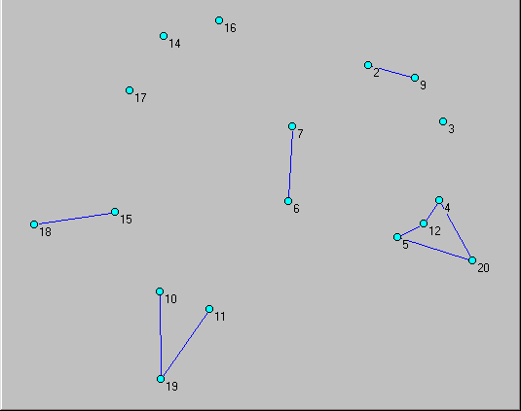
Network Diffusion & Peer Influence
Network diffusion features
We need:
(1) reachability
(2) distance
(3) local clustering
(4) multiple routes
(5) star spreaders
Much of the work on “core groups” or “at risk” populations focus on high-degree nodes. The assumption is that high-degree nodes are likely to contact lots of people.
Notes:
Working through the mathematical requirements for the intuitive notion of ‘widely distributed’ ties, we come up with the following two equivalent definitions of structural cohesion
(read).

Slide 21
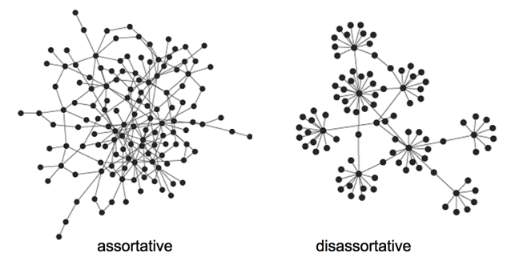
Network Diffusion & Peer Influence
Network diffusion features
Assortative mixing:
A more traditional way to think about “star” effects.

Slide 22
Network Diffusion & Peer Influence
Network diffusion features: simulation test
Simulation study: How do these different features compare over a collection of observed nets?
For each network trial:
Fix dyadic transmission probability
Randomly select a node as seed
Trace the diffusion path across the network
Measure speed & extent of spread
Model extent of spread by structural characteristics
First run: Add Health:
simple diffusion process
dyadic probability set to 0.08
500 trials in each network.
Then expand to :
Different assumptions of dyadic transmission probability
Different data set (Facebook)
Complex diffusion models

Slide 23
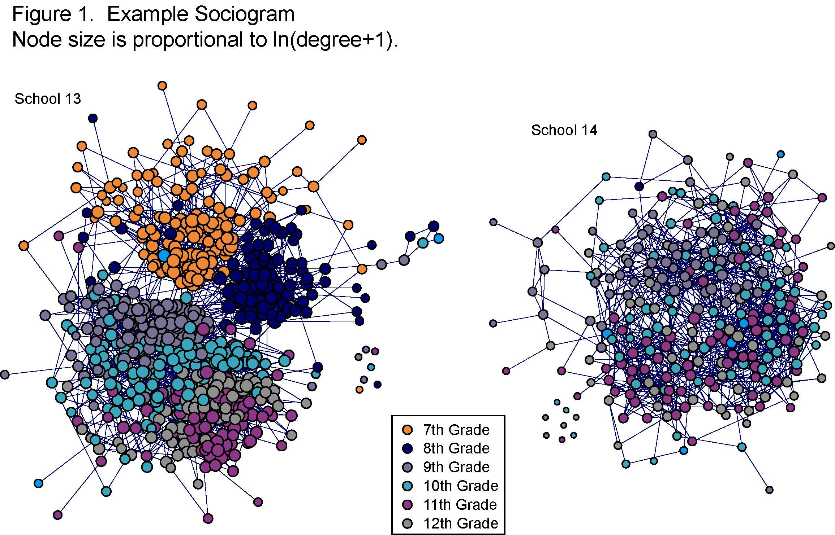
Network Diffusion & Peer Influence
Network diffusion features: simulation test

Slide 24
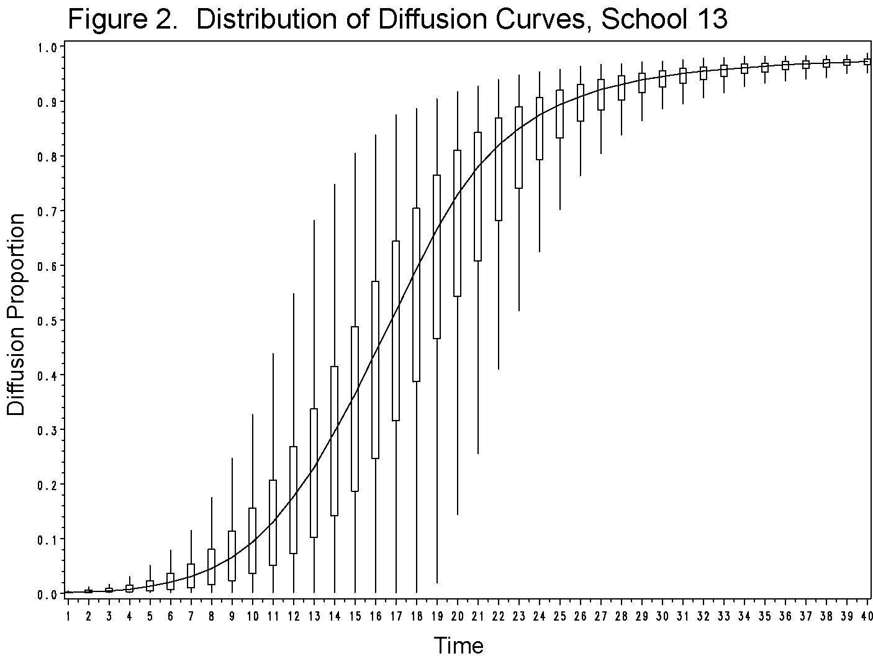
Network Diffusion & Peer Influence
Network diffusion features: simulation test

Slide 25
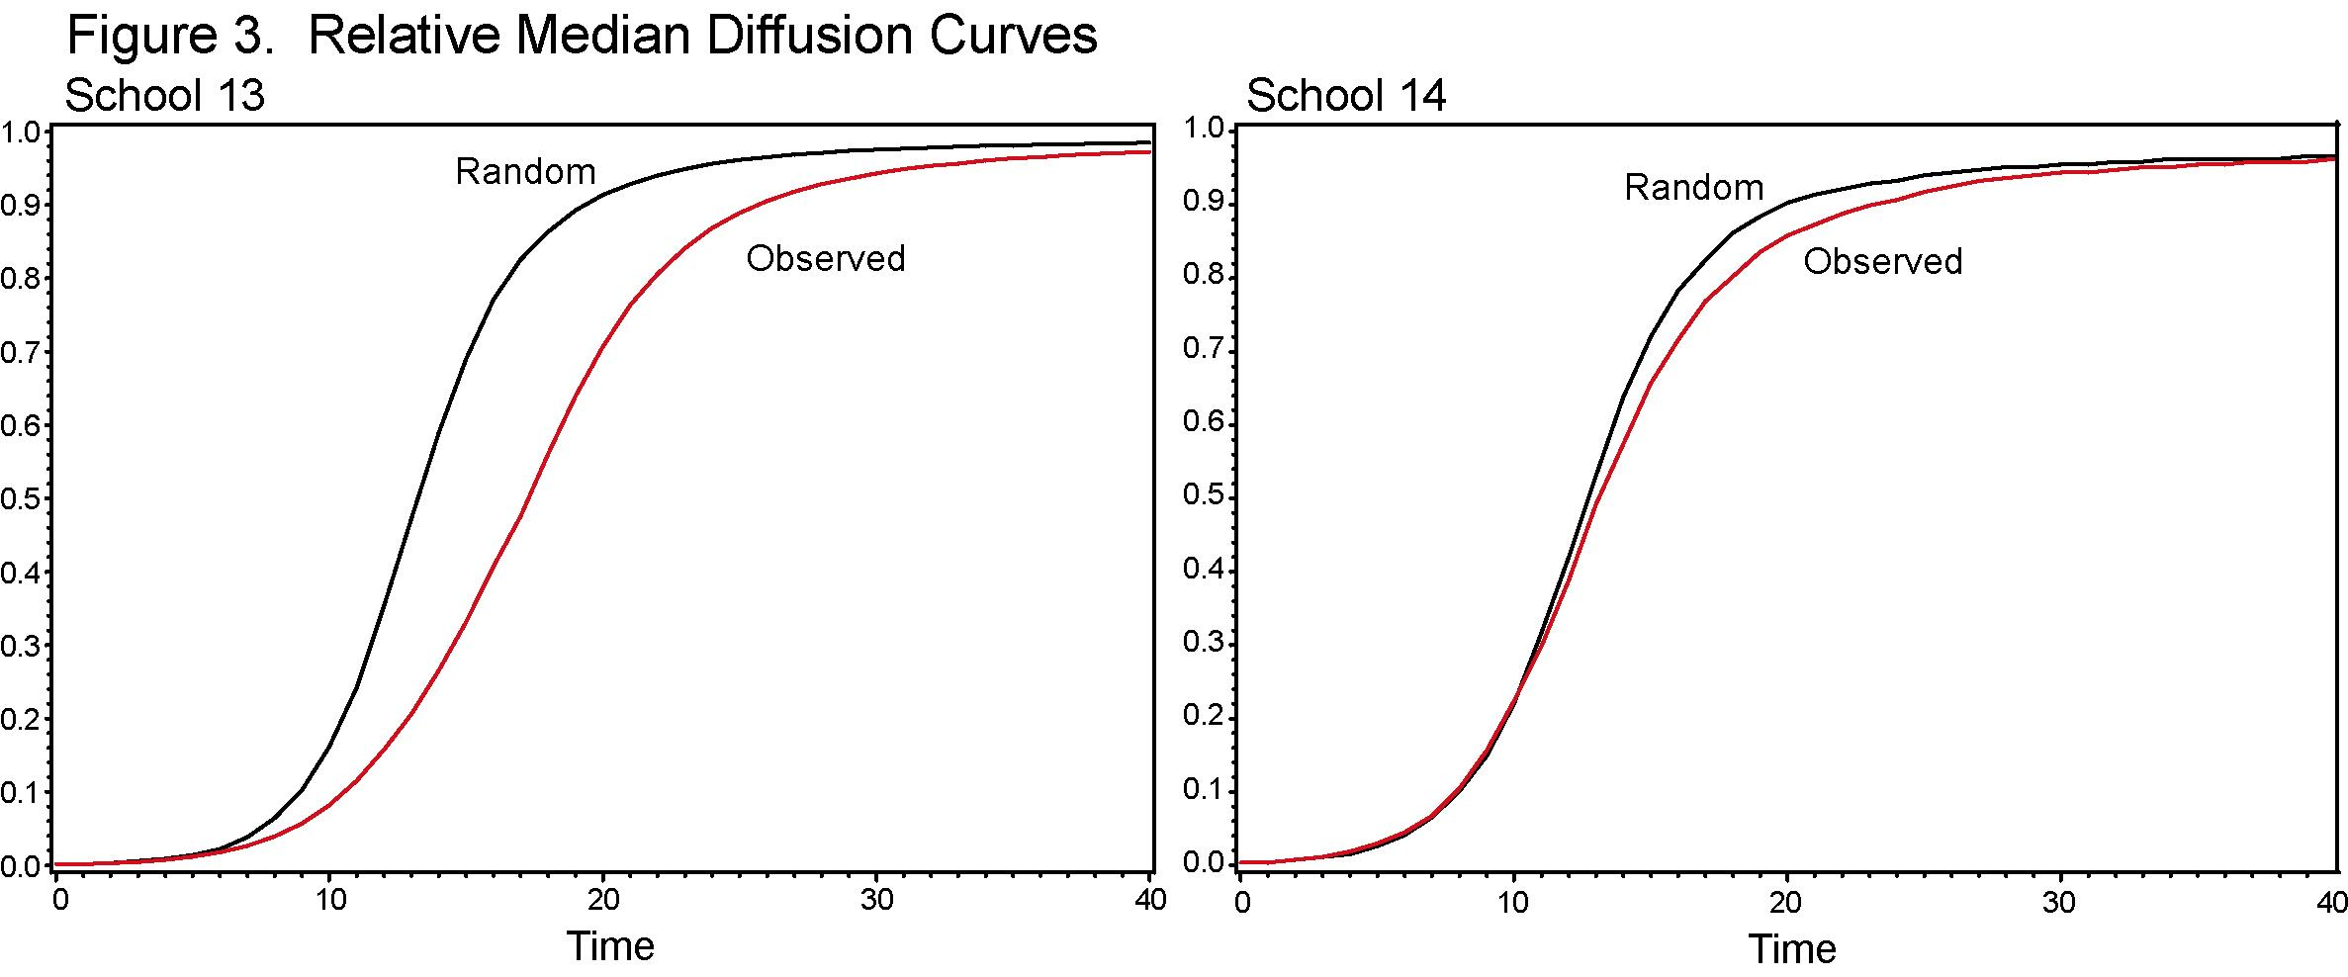
Network Diffusion & Peer Influence
Network diffusion features: simulation test
Define as a general measure of the “diffusion susceptibility” of a graph’s structure as the ratio of the area under the observed curve to the area under the curve for a matching random network. As this gets smaller than 1.0, you get effectively slower median transmission.

Slide 26
Network Diffusion & Peer Influence
Network diffusion features: simulation test

Slide 27
Network Diffusion & Peer Influence
Network diffusion features: simulation test

Slide 28
Network Diffusion & Peer Influence
Network diffusion features: simulation test

Slide 29
Network Diffusion & Peer Influence
Network diffusion features: simulation test

Slide 30
Network Diffusion & Peer Influence
A closer look at emerging connectivity
Traditional “core group” models have a local-vision understanding of risk: those with lots of ties (high degree) are the focus for intervention and actions.
In the short time-windows necessary for STD transfer, low-degree networks are the relevant features for transmission. What sorts of networks emerge when average degree (in the short run) is held to small numbers?
How does the shape of the degree distribution matter? If activity is homogeneous do we get fundamentally different networks than if it is very heterogeneous?

Slide 31
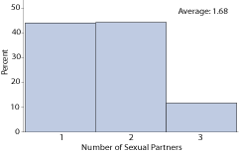
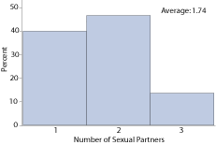
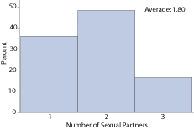
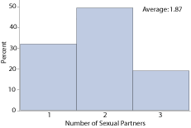
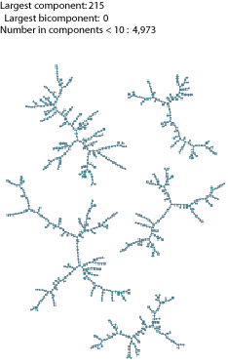
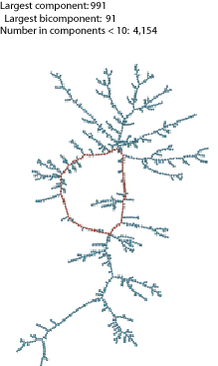
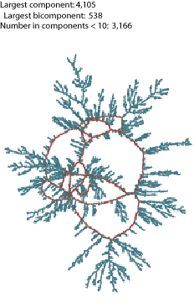
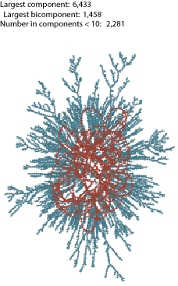
Network Diffusion & Peer Influence
A closer look at emerging connectivity
Emergent Connectivity in low-degree networks
Partner
Distribution
Component
Size/Shape

Slide 32
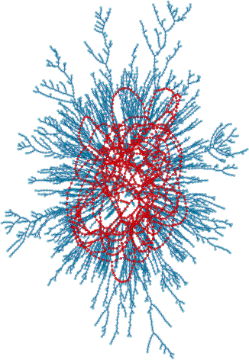
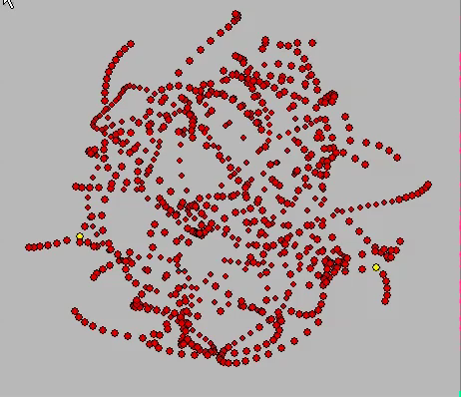
Network Diffusion & Peer Influence
A closer look at emerging connectivity

Slide 33
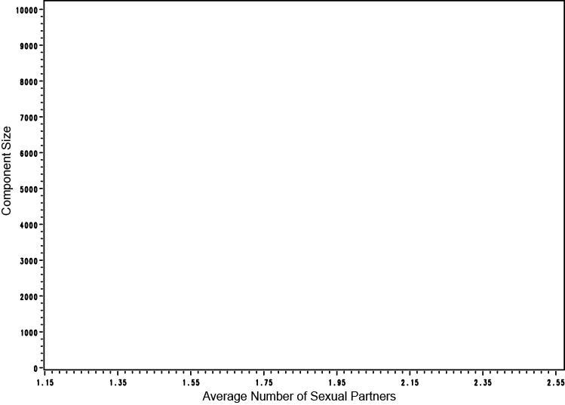
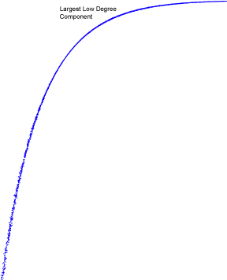
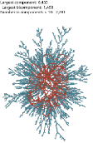
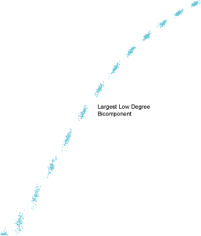
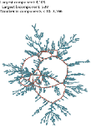
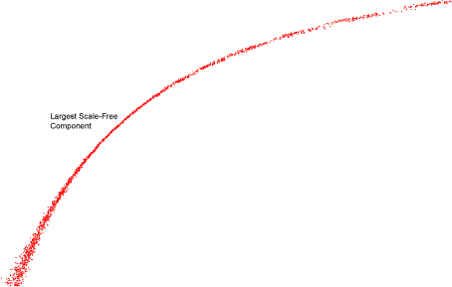
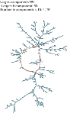
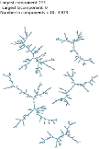
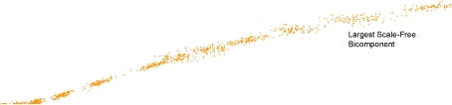
Network Diffusion & Peer Influence
A closer look at emerging connectivity
In both distributions, a giant component & reconnected core emerges as density increases, but at very different speeds and ultimate extent.

Slide 34
Network Diffusion & Peer Influence
A closer look at emerging connectivity
Very small changes in degree generate a quick cascade to large connected components. While not quite as rapid, STD cores follow a similar pattern, emerging rapidly and rising steadily with small changes in the degree distribution.
This suggests that, even in the short run (days or weeks, in some populations) large connected cores can emerge covering the majority of the interacting population, which can sustain disease.
The analogous curve for the long-tailed (“scale free”) distribution is gentler: with components emerging slowly and bicomponents never reaching a large set.

Slide 35
Network Diffusion & Peer Influence
A closer look at emerging connectivity
What distinguishes these two distributions?
Shape

Slide 36
Network Diffusion & Peer Influence
A closer look at emerging connectivity
What distinguishes these two distributions? Shape:
The scale-free network’s signature is the long-tail
So what effect does changes in the shape have on connectivity?

Slide 37
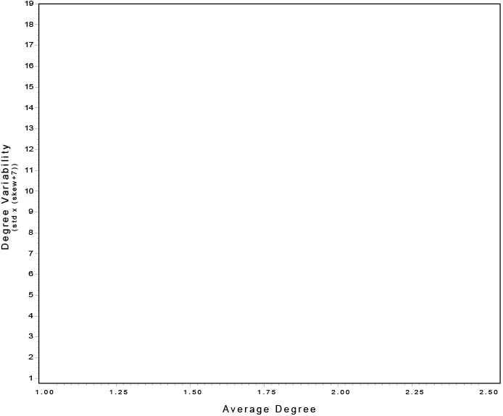




Network Diffusion & Peer Influence
A closer look at emerging connectivity
← Dispersion x Skewness →
← Volume →
Notes:
So we can define a space of potential degree distributions by two dimensions: volume & Variability

Slide 38

Network Diffusion & Peer Influence
A closer look at emerging connectivity
Search Procedure:
Identify all valid degree distributions with the given mean degree and a maximum of 6 w. brute force search.
Map them to this space
Simulate networks each degree distribution
Measure size of components & Bicomponents
Notes:
So we can define a space of potential degree distributions by two dimensions: volume & Variability

Slide 39

Network Diffusion & Peer Influence
A closer look at emerging connectivity
Based on work supported by R21-HD072810 (NICHD, Moody PI), R01 HD068523-01 (NICHD, Moody PI), R01 DA012831-05 (NIDA Morris, Martina PI),
Notes:
So we can define a space of potential degree distributions by two dimensions: volume & Variability

Slide 40

Network Diffusion & Peer Influence
A closer look at emerging connectivity
Based on work supported by R21-HD072810 (NICHD, Moody PI), R01 HD068523-01 (NICHD, Moody PI), R01 DA012831-05 (NIDA Morris, Martina PI),
Notes:
So we can define a space of potential degree distributions by two dimensions: volume & Variability

Slide 41


Network Diffusion & Peer Influence
A closer look at emerging connectivity
C:45%, B: 8.5%
Based on work supported by R21-HD072810 (NICHD, Moody PI), R01 HD068523-01 (NICHD, Moody PI), R01 DA012831-05 (NIDA Morris, Martina PI),
Notes:
So we can define a space of potential degree distributions by two dimensions: volume & Variability

Slide 42


Network Diffusion & Peer Influence
A closer look at emerging connectivity
C:45%, B: 8.5%
Based on work supported by R21-HD072810 (NICHD, Moody PI), R01 HD068523-01 (NICHD, Moody PI), R01 DA012831-05 (NIDA Morris, Martina PI),
Notes:
So we can define a space of potential degree distributions by two dimensions: volume & Variability

Slide 43


Network Diffusion & Peer Influence
A closer look at emerging connectivity
C:83%, B: 36%
Based on work supported by R21-HD072810 (NICHD, Moody PI), R01 HD068523-01 (NICHD, Moody PI), R01 DA012831-05 (NIDA Morris, Martina PI),
Notes:
So we can define a space of potential degree distributions by two dimensions: volume & Variability

Slide 44


Network Diffusion & Peer Influence
A closer look at emerging connectivity
C:99%, B: 86%
Based on work supported by R21-HD072810 (NICHD, Moody PI), R01 HD068523-01 (NICHD, Moody PI), R01 DA012831-05 (NIDA Morris, Martina PI),

Slide 45


Network Diffusion & Peer Influence
A closer look at emerging connectivity
Largest Component
(at least 1 path)
Largest Bicomponent
(at least 2 paths)
Based on work supported by R21-HD072810 (NICHD, Moody PI), R01 HD068523-01 (NICHD, Moody PI), R01 DA012831-05 (NIDA Morris, Martina PI),
Notes:
So we can define a space of potential degree distributions by two dimensions: volume & Variability

Slide 46

Network Diffusion & Peer Influence
A closer look at emerging connectivity
Notes:
So we can define a space of potential degree distributions by two dimensions: volume & Variability

Slide 47
Network Diffusion & Peer Influence
Relational Dynamics
Key Question: What features of a network contribute most to diffusion potential?
In addition to* the dyadic probability that one actor passes something to another (p_{ij}), two factors affect flow through a network:
Topology
the shape, or form, of the network
- Example: one actor cannot pass information to another unless they are either directly or indirectly connected
Time
- the timing of contact matters
- Example: an actor cannot pass information he has not receive yet
Use simulation tools to explore the relative effects of structural connectivity features
*This is a big conditional! – lots of work on how the dyadic transmission rate may differ across populations.

Slide 48
Network Diffusion & Peer Influence
Relational Dynamics
Three relevant networks
Discussions of network effects on STD spread often speak loosely of “the network.”
There are three relevant networks that are often conflated:
The contact network. The set of pairs of people connected by sexual contact. G(V,E).
The exposure network. A subset of the edges in the contact network where timing makes it possible for one person to pass infection to another.
The transmission network. The subset of the exposure network where disease is actually passed. In most cases this is a tree layered on (2) and rooted on a source/seed node.

Slide 49

Network Diffusion & Peer Influence
Relational Dynamics
Three relevant networks
Discussions of network effects on STD spread often speak loosely of “the network.”
There are three relevant networks that are often conflated:
Who can “A” reach?
Contact network: Everyone, it is a connected component

Slide 50
Network Diffusion & Peer Influence
Relational Dynamics
Three relevant networks
Discussions of network effects on STD spread often speak loosely of “the network.”
There are three relevant networks that are often conflated:
Who can “A” reach?
Exposure network: here, node “A” could reach up to 8 others

Slide 51
Network Diffusion & Peer Influence
Relational Dynamics
Three relevant networks
Discussions of network effects on STD spread often speak loosely of “the network.”
There are three relevant networks that are often conflated:
Who can “A” reach?
Exposable Link (from A’s p.o.v.)
Contact
Transmission network: upper limit is 8 through the exposure links (dark blue). Transmission is path dependent: if no transmission to B, then also none to {K,L,O,J,M}

Slide 52
Network Diffusion & Peer Influence
Relational Dynamics
Concurrency
The mapping between the contact network and the exposure network is based on relational timing. In a dynamic network, edge timing determines if something can flow down a path because things can only be passed forward in time.
Definitions:
Two edges are adjacent if they share a node.
A path is a sequence of adjacent edges (E₁, E₂, …E_{d}).
A time-ordered path is a sequence of adjacent edges where, for each pair of edges in the sequence, the start time S_{i} is less than or equal to E_{j} S(E₁) < E(E₂)
Adjacent edges are concurrent if they share a node and have start and end dates that overlap. This occurs if:
S(E₂) < E(E₁)

Slide 53
Network Diffusion & Peer Influence
Relational Dynamics
Concurrency
The mapping between the contact network and the exposure network is based on relational timing. In a dynamic network, edge timing determines if something can flow down a path because things can only be passed forward in time.
2 - 7
5 - 6
E
1 - 3
A
B
C
8 - 9
D
AB
BC
CD
CE
time
1 2 3 4 5 6 7 8 9 10
S(bc)
S(ce)
E(ce)
S(ab)
E(ab)
E(bc)

Slide 54
Network Diffusion & Peer Influence
Relational Dynamics
The constraints of time-ordered paths change our understanding of the system structure of the network. Paths make a network a system: linking actors together through indirect connections. Relational timing changes how paths cumulate in networks.
Indirect connectivity is no longer transitive:
A
1 - 2
B
3 - 4
C
1 - 2
D
Here A can reach C, and C and reach D. But A cannot reach D (nor D A). Why? Because any infection A passes to C would have happened after the relation between C and D ended.
A
1 - 2
B
3 - 4
C
1 - 2
D

Slide 55

Network Diffusion & Peer Influence
Relational Dynamics
Edge time structures are characterized by sequence, duration and overlap.
Paths between i and j, have length and duration, but these need not be symmetric even if the constituent edges are symmetric.

Slide 56
Network Diffusion & Peer Influence
Relational Dynamics
Reachability = 1.0
Implied Contact Network of 8 people in a ring
All relations Concurrent

Slide 57
Network Diffusion & Peer Influence
Relational Dynamics
8
1
7
2
6
3
5
4
Reachability = 0.71
Implied Contact Network of 8 people in a ring
Serial Monogamy (1)

Slide 58
Network Diffusion & Peer Influence
Relational Dynamics
3
2
1
2
2
1
2
3
Reachability = 0.57
Implied Contact Network of 8 people in a ring
Mixed Concurrent

Slide 59
Network Diffusion & Peer Influence
Relational Dynamics
2
1
1
2
2
1
1
2
Reachability = 0.43
Implied Contact Network of 8 people in a ring
Serial Monogamy (3)

Slide 60
Network Diffusion & Peer Influence
Relational Dynamics
Timing alone can change mean reachability from 1.0 when all ties are concurrent to 0.42.
In general, ignoring time order is equivalent to assuming all relations occur simultaneously – assumes perfect concurrency across all relations.
2
1
1
2
2
1
1
2

Slide 61

Network Diffusion & Peer Influence
Relational Dynamics
Path distances no longer simply add
4
1
A B C D E F
A 0 1 2 2 4 1
B 1 0 1 2 3 2
C 0 1 0 1 2 2
D 0 0 1 0 1 1
E 0 0 0 1 0 2
F 1 0 0 1 0 0
While a is 2 steps from d, and d is 1 step from e, a and e are 4 steps apart.
This is because the shorter path from a to e emerges after the path from d to e ended.
2

Slide 62
Network Diffusion & Peer Influence
Relational Dynamics
Aside: “shortest” can now be replaced with “fastest”
B
3 - 4
C
5 - 6
1 - 2
A
D
5 - 6
7 - 9
E
The geodesic from A to D is AE, ED and is two steps long.
But the fastest path would be AB, BC, CD, which while 3 steps long could get there by time 5 compared to time 7.
I ignore this feature for the remainder…

Slide 63

Network Diffusion & Peer Influence
Relational Dynamics
Concurrency affects exposure by making paths symmetric, which increases exposure down multiple “branches” of a contact sequence.
Consider a simplified example:
a b c d e f g h i j k l m
a . 1 1 1 1 1 1 1 1 1 1 1 1
b 1 . 1 1 1 1 1 1 1 1 1 1 1
c 1 1 . 1 1 1 1 1 1 1 1 1 1
d 1 1 1 . 1 1 1 1 1 1 1 1 1
e 1 1 1 1 . 1 1 1 1 1 1 1 1
f 1 1 1 1 1 . 1 1 1 1 1 1 1
g 1 1 1 1 1 1 . 1 1 1 1 1 1
h 1 1 1 1 1 1 1 . 1 1 1 1 1
i 1 1 1 1 1 1 1 1 . 1 1 1 1
j 1 1 1 1 1 1 1 1 1 . 1 1 1
k 1 1 1 1 1 1 1 1 1 1 . 1 1
l 1 1 1 1 1 1 1 1 1 1 1 . 1
m 1 1 1 1 1 1 1 1 1 1 1 1 .
All edges concurrent

Slide 64

Network Diffusion & Peer Influence
Relational Dynamics
Concurrency affects exposure by making paths symmetric, which increases exposure down multiple “branches” of a contact sequence.
Consider a simplified example:
a b c d e f g h i j k l m
a . 1 1 1 1 1 1 1 1 1 1 1 1
b 1 . 1 1 1 1 1 1 1 1 1 1 1
c 1 1 . 1 1 1 1 1 1 1 1 1 1
d 1 1 1 . 1 1 1 1 1 1 1 1 1
e 1 1 1 1 . 1 1 1 1 1 1 1 1
f 1 1 1 1 1 . 1 1 1 1 1 1 1
g 0 0 0 1 0 0 . 1 1 1 1 1 1
h 0 0 0 1 0 0 1 . 1 1 1 1 1
i 0 0 0 1 0 0 1 1 . 1 1 1 1
j 0 0 0 1 0 0 1 1 1 . 1 1 1
k 0 0 0 1 0 0 1 1 1 1 . 1 1
l 0 0 0 1 0 0 1 1 1 1 1 . 1
m 0 0 0 1 0 0 1 1 1 1 1 1 .
All edges except gd concurrent

Slide 65

Network Diffusion & Peer Influence
Relational Dynamics
Concurrency affects exposure by making paths symmetric, which increases exposure down multiple “branches” of a contact sequence.
Consider a simplified example:
a b c d e f g h i j k l m
a . 1 1 1 1 1 1 0 0 0 0 0 0
b 1 . 1 1 1 1 1 0 0 0 0 0 0
c 1 1 . 1 1 1 1 0 0 0 0 0 0
d 1 1 1 . 1 1 1 0 0 0 0 0 0
e 1 1 1 1 . 1 1 0 0 0 0 0 0
f 1 1 1 1 1 . 1 0 0 0 0 0 0
g 0 0 0 1 0 0 . 1 1 1 1 1 1
h 0 0 0 0 0 0 1 . 1 1 1 1 1
i 0 0 0 0 0 0 1 1 . 1 1 1 1
j 0 0 0 0 0 0 1 1 1 . 1 1 1
k 0 0 0 0 0 0 1 1 1 1 . 1 1
l 0 0 0 0 0 0 1 1 1 1 1 . 1
m 0 0 0 0 0 0 1 1 1 1 1 1 .
All edges gd after all others:
The concurrency status of {dg} determines which “side” of the graph is exposed. Note this effect happens at the system level – the correlation between exposure and node-level timing is essentially zero (d/g excepted)

Slide 66

Network Diffusion & Peer Influence
Relational Dynamics
Observed infection paths from 10 seeds in an STD simulation, edges coded for concurrency status.
Resulting infection trace from a simulation (Morris et al, AJPH 2010).

Slide 67

Network Diffusion & Peer Influence
Relational Dynamics
Observed infection paths from 10 seeds in an STD simulation, edges coded for concurrency status.
Resulting infection trace from a simulation (Morris et al, AJPH 2010).

Slide 68
Network Diffusion & Peer Influence
Relational Dynamics
Timing constrains potential diffusion paths in networks, since bits can flow through edges that have ended.
This means that:
Structural paths are not equivalent to the diffusion-relevant path set.
Network distances don’t build on each other.
Weakly connected components overlap without diffusion reaching across sets.
Small changes in edge timing can have dramatic effects on overall diffusion
Diffusion potential is maximized when edges are concurrent and minimized when they are “inter-woven” to limit reachability.
Combined, this means that many of our standard path-based network measures will be incorrect on dynamic graphs.

Slide 69
Network Diffusion & Peer Influence
Relational Dynamics – other implication of dynamic nets (briefly)
Structural measurement implications
The distribution of paths is important for many of the measures we typically construct on networks, and these will be change if timing is taken into consideration:
Centrality:
Closeness centrality
Path Centrality
Information Centrality
Betweenness centrality
Network Topography
Clustering
Path Distance
Groups & Roles:
Correspondence between degree-based position and reach-based position
Structural Cohesion & Embeddedness
Opportunities for Time-based block-models (similar reachability profiles)
In general, any measures that take the systems nature of the graph into account will differ.

Slide 70
Network Diffusion & Peer Influence
Relational Dynamics – other implication of dynamic nets (briefly)
Structural measurement implications
New versions of classic reachability measures:
Temporal reach: The ij cell = 1 if i can reach j through time.
Temporal geodesic: The ij cell equals the number of steps in the shortest path linking i to j over time.
Temporal paths: The ij cell equals the number of time-ordered paths linking i to j.
These will only equal the standard versions when all ties are concurrent.
Duration explicit measures
4) Quickest path: The ij cell equals the shortest time within which i could reach j.
5) Earliest path: The ij cell equals the real-clock time when i could first reach j.
6) Latest path: The ij cell equals the real-clock time when i could last reach j.
7) Exposure duration: The ij cell equals the longest (shortest) interval of time over which i could transfer a good to j.
Each of these also imply different types of “betweenness” roles for nodes or edges, such as a “limiting time” edge, which would be the edge whose comparatively short duration places the greatest limits on other paths.

Slide 71
Network Diffusion & Peer Influence
Structural Moderators of Timing Effects
Topology & Time interact: How relational sequencing affects diffusion is conditioned by the structural patterns of relations.
Examples:
- Time limitations mean star nodes can’t interact with everyone at each time tick; effects of high degree are thus limited by schedule/availabiltiy
- If within-cluster ties are also more frequent than between cluster ties, then the effects of communities will be magnified.
-Multiple connectivity should provide routes around breaks built by temporal sequence.

Slide 72

Network Diffusion & Peer Influence
Structural Moderators of Timing Effects
Measures
Dependent variable: Reachability in the exposure graph. This is the proportion of pairs in the network that are reachable in time.
Exposure Graph Density

Slide 73

Network Diffusion & Peer Influence
Structural Moderators of Timing Effects
Measures: Independent variables
Features of the topology. Of key interest is the level of structural cohesion.
 | 1 | 2 | 3 | 4 | 5 | 6 | 7 | 8 | 9
1 | -- | 1 | 1 | 1 | 1 | 1 | 1 | 1 | 1
2 | 1 | -- | 2 | 2 | 2 | 1 | 1 | 1 | 1
3 | 1 | 2 | -- | 2 | 2 | 1 | 1 | 1 | 1
4 | 1 | 2 | 2 | -- | 2 | 1 | 1 | 1 | 1
5 | 1 | 2 | 2 | 2 | -- | 1 | 1 | 1 | 1
6 | 1 | 1 | 1 | 1 | 1 | -- | 2 | 2 | 1
7 | 1 | 1 | 1 | 1 | 1 | 2 | -- | 2 | 1
8 | 1 | 1 | 1 | 1 | 1 | 2 | 2 | -- | 1
9 | 1 | 1 | 1 | 1 | 1 | 1 | 1 | 1 | --
Cell Value = highest k-connected component pair belongs to.
Average = 1.25

Slide 74

Network Diffusion & Peer Influence
Structural Moderators of Timing Effects
Measures: Independent variables
Features of the topology. Of key interest is the level of structural cohesion.
 | 1 | 2 | 3 | 4 | 5 | 6 | 7 | 8 | 9
1 | -- | 1 | 1 | 1 | 1 | 1 | 1 | 1 | 1
2 | 1 | -- | 3 | 3 | 3 | 2 | 2 | 2 | 1
3 | 1 | 3 | -- | 3 | 3 | 2 | 2 | 2 | 1
4 | 1 | 3 | 3 | -- | 3 | 2 | 2 | 2 | 1
5 | 1 | 3 | 3 | 3 | -- | 2 | 2 | 2 | 1
6 | 1 | 2 | 2 | 2 | 2 | -- | 2 | 2 | 1
7 | 1 | 2 | 2 | 2 | 2 | 2 | -- | 2 | 1
8 | 1 | 2 | 2 | 2 | 2 | 2 | 2 | -- | 1
9 | 1 | 1 | 1 | 1 | 1 | 1 | 1 | 1 | --
Cell Value = highest k-connected component pair belongs to.
Average = 1.6

Slide 75

Network Diffusion & Peer Influence
Structural Moderators of Timing Effects
Measures: Independent variables
Features of the topology. Of key interest is the level of structural cohesion.
Average connectivity

Slide 76




Network Diffusion & Peer Influence
Structural Moderators of Timing Effects
Volume
Distance
Connectivity
Nodes: 148
Mean Deg: 6.16
Density: 0.042
Centralization: 0.187
Mean: 3.59
Diameter: 5
Centralization: 0.312
Largest BC: 0.51
Pairwise K: 1.57
“High Cohesive”
Nodes: 80
Mean Deg: 5.27
Density: 0.067
Centralization: 0.373
Mean: 3.02
Diameter: 5
Centralization: 0.413
Largest BC: 0.33
Pairwise K: 1.34
Nodes: 154
Mean Deg: 3.71
Density: 0.025
Centralization: 0.147
Mean: 4.99
Diameter: 8
Centralization: 0.259
Largest BC: 0.08
Pairwise K: 1.07
“Low Cohesive”
Nodes: 128
Mean Deg: 3.39
Density: 0.027
Centralization: 0.205
Mean: 4.55
Diameter: 6
Centralization: 0.301
Largest BC:
Pairwise K: 1.06
Exemplar independent variables
Notes:
N
netname Obs Minimum Maximum Skewness Std Dev Mean
ƒƒƒƒƒƒƒƒƒƒƒƒƒƒƒƒƒƒƒƒƒƒƒƒƒƒƒƒƒƒƒƒƒƒƒƒƒƒƒƒƒƒƒƒƒƒƒƒƒƒƒƒƒƒƒƒƒƒƒƒƒƒƒƒƒƒƒƒƒƒƒƒƒƒƒƒƒƒƒƒƒƒƒƒƒƒƒƒƒƒƒƒƒƒƒ
coauth1 83 1.0000000 22.0000000 3.6859903 3.7005134 3.0361446
ransamp1 148 1.0000000 33.0000000 1.6732238 5.9841674 6.1621622
ransamp2 80 1.0000000 34.0000000 3.8996277 4.5255254 5.2750000
ransamp3 154 1.0000000 26.0000000 2.7223879 3.5252855 3.7142857
ransamp4 128 1.0000000 29.0000000 4.1948986 3.4441194 3.3906250
ƒƒƒƒƒƒƒƒƒƒƒƒƒƒƒƒƒƒƒƒƒƒƒƒƒƒƒƒƒƒƒƒƒƒƒƒƒƒƒƒƒƒƒƒƒƒƒƒƒƒƒƒƒƒƒƒƒƒƒƒƒƒƒƒƒƒƒƒƒƒƒƒƒƒƒƒƒƒƒƒƒƒƒƒƒƒƒƒƒƒƒƒƒƒƒ

Slide 77

Network Diffusion & Peer Influence
Structural Moderators of Timing Effects
Notes:
N
netname Obs Minimum Maximum Skewness Std Dev Mean
ƒƒƒƒƒƒƒƒƒƒƒƒƒƒƒƒƒƒƒƒƒƒƒƒƒƒƒƒƒƒƒƒƒƒƒƒƒƒƒƒƒƒƒƒƒƒƒƒƒƒƒƒƒƒƒƒƒƒƒƒƒƒƒƒƒƒƒƒƒƒƒƒƒƒƒƒƒƒƒƒƒƒƒƒƒƒƒƒƒƒƒƒƒƒƒ
coauth1 83 1.0000000 22.0000000 3.6859903 3.7005134 3.0361446
ransamp1 148 1.0000000 33.0000000 1.6732238 5.9841674 6.1621622
ransamp2 80 1.0000000 34.0000000 3.8996277 4.5255254 5.2750000
ransamp3 154 1.0000000 26.0000000 2.7223879 3.5252855 3.7142857
ransamp4 128 1.0000000 29.0000000 4.1948986 3.4441194 3.3906250
ƒƒƒƒƒƒƒƒƒƒƒƒƒƒƒƒƒƒƒƒƒƒƒƒƒƒƒƒƒƒƒƒƒƒƒƒƒƒƒƒƒƒƒƒƒƒƒƒƒƒƒƒƒƒƒƒƒƒƒƒƒƒƒƒƒƒƒƒƒƒƒƒƒƒƒƒƒƒƒƒƒƒƒƒƒƒƒƒƒƒƒƒƒƒƒ

Slide 78

Network Diffusion & Peer Influence
Structural Moderators of Timing Effects
“Low Cohesive”
Notes:
N
netname Obs Minimum Maximum Skewness Std Dev Mean
ƒƒƒƒƒƒƒƒƒƒƒƒƒƒƒƒƒƒƒƒƒƒƒƒƒƒƒƒƒƒƒƒƒƒƒƒƒƒƒƒƒƒƒƒƒƒƒƒƒƒƒƒƒƒƒƒƒƒƒƒƒƒƒƒƒƒƒƒƒƒƒƒƒƒƒƒƒƒƒƒƒƒƒƒƒƒƒƒƒƒƒƒƒƒƒ
coauth1 83 1.0000000 22.0000000 3.6859903 3.7005134 3.0361446
ransamp1 148 1.0000000 33.0000000 1.6732238 5.9841674 6.1621622
ransamp2 80 1.0000000 34.0000000 3.8996277 4.5255254 5.2750000
ransamp3 154 1.0000000 26.0000000 2.7223879 3.5252855 3.7142857
ransamp4 128 1.0000000 29.0000000 4.1948986 3.4441194 3.3906250
ƒƒƒƒƒƒƒƒƒƒƒƒƒƒƒƒƒƒƒƒƒƒƒƒƒƒƒƒƒƒƒƒƒƒƒƒƒƒƒƒƒƒƒƒƒƒƒƒƒƒƒƒƒƒƒƒƒƒƒƒƒƒƒƒƒƒƒƒƒƒƒƒƒƒƒƒƒƒƒƒƒƒƒƒƒƒƒƒƒƒƒƒƒƒƒ

Slide 79

Network Diffusion & Peer Influence
Structural Moderators of Timing Effects
Density of the Exposure Network
Proportion of relations concurrent
Notes:
N
netname Obs Minimum Maximum Skewness Std Dev Mean
ƒƒƒƒƒƒƒƒƒƒƒƒƒƒƒƒƒƒƒƒƒƒƒƒƒƒƒƒƒƒƒƒƒƒƒƒƒƒƒƒƒƒƒƒƒƒƒƒƒƒƒƒƒƒƒƒƒƒƒƒƒƒƒƒƒƒƒƒƒƒƒƒƒƒƒƒƒƒƒƒƒƒƒƒƒƒƒƒƒƒƒƒƒƒƒ
coauth1 83 1.0000000 22.0000000 3.6859903 3.7005134 3.0361446
ransamp1 148 1.0000000 33.0000000 1.6732238 5.9841674 6.1621622
ransamp2 80 1.0000000 34.0000000 3.8996277 4.5255254 5.2750000
ransamp3 154 1.0000000 26.0000000 2.7223879 3.5252855 3.7142857
ransamp4 128 1.0000000 29.0000000 4.1948986 3.4441194 3.3906250
ƒƒƒƒƒƒƒƒƒƒƒƒƒƒƒƒƒƒƒƒƒƒƒƒƒƒƒƒƒƒƒƒƒƒƒƒƒƒƒƒƒƒƒƒƒƒƒƒƒƒƒƒƒƒƒƒƒƒƒƒƒƒƒƒƒƒƒƒƒƒƒƒƒƒƒƒƒƒƒƒƒƒƒƒƒƒƒƒƒƒƒƒƒƒƒ

Slide 80

Network Diffusion & Peer Influence
Structural Moderators of Timing Effects
Colors=different nets
Panels=cohesion level
Density of the Exposure Network
Proportion of relations concurrent
Notes:
N
netname Obs Minimum Maximum Skewness Std Dev Mean
ƒƒƒƒƒƒƒƒƒƒƒƒƒƒƒƒƒƒƒƒƒƒƒƒƒƒƒƒƒƒƒƒƒƒƒƒƒƒƒƒƒƒƒƒƒƒƒƒƒƒƒƒƒƒƒƒƒƒƒƒƒƒƒƒƒƒƒƒƒƒƒƒƒƒƒƒƒƒƒƒƒƒƒƒƒƒƒƒƒƒƒƒƒƒƒ
coauth1 83 1.0000000 22.0000000 3.6859903 3.7005134 3.0361446
ransamp1 148 1.0000000 33.0000000 1.6732238 5.9841674 6.1621622
ransamp2 80 1.0000000 34.0000000 3.8996277 4.5255254 5.2750000
ransamp3 154 1.0000000 26.0000000 2.7223879 3.5252855 3.7142857
ransamp4 128 1.0000000 29.0000000 4.1948986 3.4441194 3.3906250
ƒƒƒƒƒƒƒƒƒƒƒƒƒƒƒƒƒƒƒƒƒƒƒƒƒƒƒƒƒƒƒƒƒƒƒƒƒƒƒƒƒƒƒƒƒƒƒƒƒƒƒƒƒƒƒƒƒƒƒƒƒƒƒƒƒƒƒƒƒƒƒƒƒƒƒƒƒƒƒƒƒƒƒƒƒƒƒƒƒƒƒƒƒƒƒ

Slide 81

Network Diffusion & Peer Influence
Structural Moderators of Timing Effects

Slide 82
Network Diffusion & Peer Influence
Structural Moderators of Timing Effects
Concurrency has a necessarily positive effect on potential diffusion exposure
This implies that we should see greater transmission given greater concurrency
This works by creating “multiple routes” in the exposure path structure
Structural cohesion captures multiple routes in the contact graph
Higher levels of cohesion increase exposure by directly increasing the underlying transmission substrate
There is a negative interaction between cohesion and concurrency: as cohesion increases, the relative returns to concurrency decrease.
But this comes at the cost of a higher base-level of exposure.
Notes:
82
Small Democrat Circle: Baucus, Harkin, Hollings, bumpers, Leahy, Dorgan, Reid, Wellstong, Feingold, Byrd.
Small Rep circle: Helms, Brown, Craig, Smith, Burns, Kempthorne, Thurmond, Stevens

Slide 83

Network Diffusion & Peer Influence
Structural Transmission Dynamics: beyond disease diffusion
Complex Contagion
Thus far we have focused on a “simple” dyadic diffusion parameter, pij, where the probability of passing/receiving the bit is purely dependent on discordant status of the dyad, sometimes called the “independent cascade model” (), which suggests a monotonic relation between the number of times you are exposed through peers.
High exposure could be due to repeated interaction with one person or weak interaction with many, effectively equating:
Alternative models exist. Under “complex contagion” for example, the likelihood that I accept the bit that flows through the network depends on the proportion of my peers that have the bit.

Slide 84
Network Diffusion & Peer Influence
Structural Transmission Dynamics: beyond disease diffusion
Complex Contagion
Assume adoption requires k neighbors having adopted, then transmission can only occur within dense clusters:
1
3
2
1

Slide 85






Network Diffusion & Peer Influence
Structural Transmission Dynamics: beyond disease diffusion
Complex Contagion
Assume adoption requires k neighbors having adopted, then transmission can only occur within dense clusters:
Assume pij=1, k=2, starting nodes in yellow

Slide 86


Network Diffusion & Peer Influence
Structural Transmission Dynamics: beyond disease diffusion
Complex Contagion
Assume adoption requires k neighbors having adopted, then transmission can only occur within dense clusters:
For this network under weak complex diffusion (k=2), the maximum risk size is 8.

Slide 87

Network Diffusion & Peer Influence
Structural Transmission Dynamics: beyond disease diffusion
Complex Contagion
Assume adoption requires k neighbors having adopted, then transmission can only occur within dense clusters:
One of the Prosper schools:
Start
For this network under weak complex diffusion (k=2), the maximum risk size is reaches 98%.

Slide 88

Network Diffusion & Peer Influence
Structural Transmission Dynamics: beyond disease diffusion
Complex Contagion
Can lead to widely varying sizes of potential diffusion cascades. Here’s the distribution across all PROPSPER schools:
Distribution is largely bimodal (even with a connected pair start)

Slide 89

Network Diffusion & Peer Influence
Structural Transmission Dynamics: beyond disease diffusion
Complex Contagion
Can lead to widely varying sizes of potential diffusion cascades. Here’s the distribution across all PROPSPER schools:
Network Average Proportion Reached
k=2 complex contagion
Coh=4.1
Coh=3.2
Mean Cascade Size
Coh=2.2
Coh=1.2
Coh=0.3
The governing factors are (a) curved effect of local redundancy and (b) structural cohesion

Slide 90

Network Diffusion & Peer Influence
Structural Transmission Dynamics: beyond disease diffusion
Complex Contagion
Does get used for real health work:
Here , authors assume a CC process, seeded with observed depressive cases, turn that into a Markov model and ask what parameters would maximize fit from simulated to observed.

Slide 91
Network Diffusion & Peer Influence
Structural Transmission Dynamics: beyond disease diffusion
Complex diffusion is just the most well studied of the options that combine transmission with some pairwise positional feature. This is a wide-open area for future research.
The basic idea is that transmission is increased/decreased if there is some third structural property that the susceptible & infected pair share.
This leads us into the general problem of peer influence models…when do peers change each other’s behaviors?

Slide 92
Network Diffusion & Peer Influence
Peer Influence Dynamics
Background:
Long standing research interest in how our relations shape our attitudes and behaviors.
Most often assumed mechanism is that people (through conversation or similar) change each others beliefs/opinions, which changes behavior.
This implies that position in a communication network should be related to attitudes.
Alternatives:
Modeling behavior: ego copies behavior of alter to gain respect, esteem, etc.
Distinction: Ego tries to be different from (some) alter to gain respect, esteem, etc.
Access: Ego wants to do Y, but can only do so because alter provides access (say, being old enough to buy cigarettes).

Slide 93
Network Diffusion & Peer Influence
Peer Influence Dynamics
Background:
Early work was ego-centric – people informed on their peers
Seems to have inflated PI effects by ~50% or so…either through projection of ego behavior onto peers or selective interaction (what alters do with ego may be different than what alter does all the time).
Then to cross sectional associations based on alter self-reports
Better, but still likely conflates selection with influence
Next to dynamic models:
Ego Behavior(t) ~ f(ego behavior(t-1) + alter behavior (t-1) + controls
Much better; still debate on (a) correct estimation functions, (b) unobserved selection features that confound causal inference.
Development of Actor-oriented models (SIENA)

Slide 94
Network Diffusion & Peer Influence
Peer Influence Dynamics
Background:
Finally: Experimental manipulation of peer exposure
“Gold standard” for isolation of peer effects
Likely strongly underestimates effects (as measure intent to treat, not take-up of treatment, since people may not care about relations that can be manipulated).
β(Peer(y)): Ego Inform < Alter Inform < Cross Sectional < Dynamic < Experimental. Still often find peer effects, but my sense is that we’ve (strongly) over-corrected at this point.

Slide 95
Network Diffusion & Peer Influence
Peer Influence Dynamics
Freidkin’s Structural Theory of Social Influence :
Two-part model:
Beliefs are a function of two sources:
a) Individual characteristics
Gender, Age, Race, Education, Etc. Standard sociology
b) Interpersonal influences
Actors negotiate with others

Slide 96
Network Diffusion & Peer Influence
Peer Influence Dynamics
(1)
(2)
Y⁽¹⁾ = an N x M matrix of initial opinions on M issues for N actors
X = an N x K matrix of K exogenous variable that affect Y
B = a K x M matrix of coefficients relating X to Y
α = a weight of the strength of endogenous interpersonal influences
W = an N x N matrix of interpersonal influences

Slide 97
Network Diffusion & Peer Influence
Peer Influence Dynamics
(1)
This is the standard sociology model for explaining anything: the General Linear Model.
It says that a dependent variable (Y) is some function (B) of a set of independent variables (X). At the individual level, the model says that:
Usually, one of the X variables is ε, the model error term.

Slide 98
Network Diffusion & Peer Influence
Peer Influence Dynamics
(2)
This part of the model taps social influence. It says that each person’s final opinion is a weighted average of their own initial opinions
And the opinions of those they communicate with (which can include their own current opinions)

Slide 99
Network Diffusion & Peer Influence
Peer Influence Dynamics
The key to the peer influence part of the model is W, a matrix of interpersonal weights. W is a function of the communication structure of the network, and is usually a transformation of the adjacency matrix. In general:
Various specifications of the model change the value of w_{ii}, the extent to which one weighs their own current opinion and the relative weight of alters.

Slide 100
Network Diffusion & Peer Influence
Peer Influence Dynamics
1
2
Self weight:
1 2 3 4
1 1 1 1 0
2 1 1 1 0
3 1 1 1 1
4 0 0 1 1
1 2 3 4
1 .33 .33 .33 0
2 .33 .33 .33 0
3 .25 .25 .25 .25
4 0 0 .50 .50
Even
3
4
1 2 3 4
1 2 1 1 0
2 1 2 1 0
3 1 1 2 1
4 0 0 1 2
1 2 3 4
1 .50 .25 .25 0
2 .25 .50 .25 0
3 .20 .20 .40 .20
4 0 0 .33 .67
2*self
1 2 3 4
1 2 1 1 0
2 1 2 1 0
3 1 1 3 1
4 0 0 1 1
1 2 3 4
1 .50 .25 .25 0
2 .25 .50 .25 0
3 .17 .17 .50 .17
4 0 0 .50 .50
degree

Slide 101
Network Diffusion & Peer Influence
Peer Influence Dynamics
Formal Properties of the model
(2)
When interpersonal influence is complete, model reduces to:
When interpersonal influence is absent, model reduces to:

Slide 102
Network Diffusion & Peer Influence
Peer Influence Dynamics
Formal Properties of the model
If we allow the model to run over t and W remains constant:
The model is directly related to spatial econometric models:
Where the two coefficients (α and β) are estimated directly (See Doreian, 1982, SMR).
This is the linear network auto correlation model, best bet with cross-sectional data (and randomization trick to estimate se)

Slide 103
Network Diffusion & Peer Influence
Peer Influence Dynamics
Simple example
1
2
1 2 3 4
1 .33 .33 .33 0
2 .33 .33 .33 0
3 .25 .25 .25 .25
4 0 0 .50 .50
Y
1
3
5
7
3
α = .8
4
T: 0 1 2 3 4 5 6 7
1.00 2.60 2.81 2.93 2.98 3.00 3.01 3.01
3.00 3.00 3.21 3.33 3.38 3.40 3.41 3.41
5.00 4.20 4.20 4.16 4.14 4.14 4.13 4.13
7.00 6.20 5.56 5.30 5.18 5.13 5.11 5.10
By t=7, still variability in Y

Slide 104
Network Diffusion & Peer Influence
Peer Influence Dynamics
Simple example
1
2
1 2 3 4
1 .33 .33 .33 0
2 .33 .33 .33 0
3 .25 .25 .25 .25
4 0 0 .50 .50
Y
1
3
5
7
3
α = 1.0
4
T: 0 1 2 3 4 5 6 7
1.00 3.00 3.33 3.56 3.68 3.74 3.78 3.81
3.00 3.00 3.33 3.56 3.68 3.74 3.78 3.81
5.00 4.00 4.00 3.92 3.88 3.86 3.85 3.84
7.00 6.00 5.00 4.50 4.21 4.05 3.95 3.90
By t=7, almost no variability in Y

Slide 105

Network Diffusion & Peer Influence
Peer Influence Dynamics
Extended example: building intuition
Consider a network with three cohesive groups, and an initially random distribution of opinions:

Slide 106

Simulated Peer Influence:
75 actors, 2 initially random opinions, Alpha = .8, 7 iterations

Slide 107

Simulated Peer Influence:
75 actors, 2 initially random opinions, Alpha = .8, 7 iterations

Slide 108

Simulated Peer Influence:
75 actors, 2 initially random opinions, Alpha = .8, 7 iterations

Slide 109

Simulated Peer Influence:
75 actors, 2 initially random opinions, Alpha = .8, 7 iterations

Slide 110

Simulated Peer Influence:
75 actors, 2 initially random opinions, Alpha = .8, 7 iterations

Slide 111

Simulated Peer Influence:
75 actors, 2 initially random opinions, Alpha = .8, 7 iterations

Slide 112

Simulated Peer Influence:
75 actors, 2 initially random opinions, Alpha = .8, 7 iterations

Slide 113

Simulated Peer Influence:
75 actors, 2 initially random opinions, Alpha = .8, 7 iterations

Slide 114

Network Diffusion & Peer Influence
Peer Influence Dynamics
Extended example: building intuition
Consider a network with three cohesive groups, and an initially random distribution of opinions:
Now weight in-group ties higher than between group ties

Slide 115

Simulated Peer Influence:
75 actors, 2 initially random opinions, Alpha = .8, 7 iterations, in-group tie: 2

Slide 116


Slide 117


Slide 118


Slide 119


Slide 120


Slide 121
Network Diffusion & Peer Influence
Peer Influence Dynamics
Consider the implications for populations of different structures. For example, we might have two groups, a large orthodox population and a small heterodox population. We can imagine the groups mixing in various levels:
Heterodox: 10 people
Orthodox: 100 People
Little Mixing
Moderate Mixing
Heavy Mixing
.95 .001
.001 .02
.95 .008
.008 .02
.95 .05
.05 .02

Slide 122



Light
Heavy
Moderate

Slide 123

Light mixing

Slide 124

Light mixing

Slide 125

Light mixing

Slide 126

Light mixing

Slide 127

Light mixing

Slide 128

Light mixing

Slide 129

Moderate mixing

Slide 130

Moderate mixing

Slide 131

Moderate mixing

Slide 132

Moderate mixing

Slide 133

Moderate mixing

Slide 134

Moderate mixing

Slide 135

High mixing

Slide 136

High mixing

Slide 137

High mixing

Slide 138

High mixing

Slide 139

High mixing

Slide 140

High mixing

Slide 141
Network Diffusion & Peer Influence
Peer Influence Dynamics
In an unbalanced situation (small group vs large group) the extent of contact can easily overwhelm the small group. Applications of this idea are evident in:
Missionary work (Must be certain to send missionaries out into the world with strong in-group contacts)
Overcoming deviant culture (I.e. youth gangs vs. adults)
This is also the mechanism behind why most youth peer influence is a *good* thing – most youth are well behavior and civic minded…so are exerting positive influences on their peers.

Slide 142
Network Diffusion & Peer Influence
Peer Influence Dynamics
Friedkin (1998) generalizes the model so that alpha varies across people.
(1) simply changing α to a vector (A), which then changes each person’s opinion directly
(2) by linking the self weight (w_{ii}) to alpha.
Were A is a diagonal matrix of endogenous weights, with 0 < a_{ii} < 1. A further restriction on the model sets w_{ii} = 1-a_{ii}
This leads to a great deal more flexibility in the theory, and some interesting insights. Consider the case of group opinion leaders with unchanging opinions (I.e. many people have high a_{ii}, while a few have low):

Slide 143

Peer Opinion Leaders
Group 1
Leaders
Group 2
Leaders
Group 3
Leaders

Slide 144

Peer Opinion Leaders

Slide 145

Peer Opinion Leaders

Slide 146

Peer Opinion Leaders

Slide 147

Peer Opinion Leaders

Slide 148

Peer Opinion Leaders

Slide 149
Network Diffusion & Peer Influence
Peer Influence Dynamics
Further extensions of the model might:
Time dependent α: people likely value other’s opinions more early than later in a decision context
Interact α with XB: people’s self weights are a function of their behaviors & attributes
Make W dependent on structure of the network (weight transitive ties greater than intransitive ties, for example)
Time dependent W: The network of contacts does not remain constant, but is dynamic, meaning that influence likely moves unevenly through the network
And others likely abound….

Slide 150
Network Diffusion & Peer Influence
Peer Influence Dynamics
There are two common ways to test for peer associations through networks.
The first estimates the parameters (α and β) of the network autocorrelation model directly, the second transforms the network into a dyadic model, predicting similarity among actors.
Peer influence model:
This is the linear network autocorrelation model, and as specified, the model makes strong assumptions about equilibrium opinion and static relations.
→ Some variants on this also expand e to include alternative autocorrelation in the error structure.

Slide 151
Network Diffusion & Peer Influence
Peer Influence Dynamics
There are two common ways to test for peer associations through networks.
The first estimates the parameters (α and β) of the network autocorrelation model directly, the second transforms the network into a dyadic model, predicting similarity among actors.
Peer influence model:
Note that since WY^{∞ is a} a simple vector -- weighted mean of friends Y -- which can be constructed and added to your GLM model. That is, multiple Y by a W matrix, and run the regression with WY as a new variable, and the regression coefficient is an estimate of α. This is what Doriean calls the QAD estimate of peer influence.
It’s wrong, a will be biased, but it’s often not terribly wrong if most obvious selection factors are built int0 X

Slide 152
Network Diffusion & Peer Influence
Peer Influence Dynamics
An obvious problem with this specification is that cases are, by definition, not independent, hence “network autocorrelation” terminology.
In practice, the QAD approach (perhaps combined with a GLS estimator) results in empirical estimates that are “virtually indistinguishable” from MLE (Doreian et al, 1984)
The proper way to estimate the peer equation is to use maximum likelihood estimates, and Doreian gives the formulas for this in his paper, and Carter Butts has implemented in in R with the LNAM procedure.
An alternative is to use non-parametric approaches, such as the Quadratic Assignment Procedure, to estimate the effects.
Notes:
Doreian, Patrik, Klaus Teuter and Chi-Hsein Wang. 1984. “Network Autocorrelation Models: Some monte Carlo Results” Sociological Methods and Research, 13:155-220

Slide 153
Network Diffusion & Peer Influence
Peer Influence Dynamics
Peer influence through Dyad Models
Another way to get at peer influence is not through the level of Y, but by assessing the similarity of connected peers. Recall the simulated example: peer influence is reflected in how close points are to each other.

Slide 154
Network Diffusion & Peer Influence
Peer Influence Dynamics
Peer influence through Dyad Models
The model is now expressed at the dyad level as:
Where Y is a matrix of similarities, A is an adjacency matrix, and X_{k} is a matrix of similarities on attributes
Advantages include ease of specifying relation-specific similarity functions. You can add different features of a relation by adjusting/adding “A_{ij}” variables.
Disadvantage is that now in addition to network autocorrelation, you have repeated cases (on both sides).
But these can be dealt with using non-parametric modeling & testing techniques (QAP, for example). (which we will go over this afternoon)

Slide 155
Network Diffusion & Peer Influence
Peer Influence & Health: Current Lit & Controversies

Slide 156
Network Diffusion & Peer Influence
Peer Influence & Health: Current Lit & Controversies
Used the friend/relative tracking data from a larger heart-health study to identify network contacts, including friends.

Slide 157

Network Diffusion & Peer Influence
Peer Influence & Health: Current Lit & Controversies
Used the friend/relative tracking data from a larger heart-health study to identify network contacts, including friends.

Slide 158
Network Diffusion & Peer Influence
Peer Influence & Health: Current Lit & Controversies
Used the friend/relative tracking data from a larger heart-health study to identify network contacts, including friends.

Slide 159
Network Diffusion & Peer Influence
Peer Influence & Health: Current Lit & Controversies
Used the friend/relative tracking data from a larger heart-health study to identify network contacts, including friends.

Slide 160
Network Diffusion & Peer Influence
Peer Influence & Health: Current Lit & Controversies
Used the friend/relative tracking data from a larger heart-health study to identify network contacts, including friends.

Slide 161
Network Diffusion & Peer Influence
Peer Influence & Health: Current Lit & Controversies
Used the friend/relative tracking data from a larger heart-health study to identify network contacts, including friends.

Slide 162
Network Diffusion & Peer Influence
Peer Influence & Health: Current Lit & Controversies
Used the friend/relative tracking data from a larger heart-health study to identify network contacts, including friends.

Slide 163
Network Diffusion & Peer Influence
Peer Influence & Health: Current Lit & Controversies
Used the friend/relative tracking data from a larger heart-health study to identify network contacts, including friends.
The network shows significant evidence of weight-homophily

Slide 164
Network Diffusion & Peer Influence
Peer Influence & Health: Current Lit & Controversies
Used the friend/relative tracking data from a larger heart-health study to identify network contacts, including friends.
Effects of peer obesity on ego, by peer type
Edge-wise regressions of the form:
Ego is repeated for all alters; models include random effects on ego id

Slide 165
Network Diffusion & Peer Influence
Peer Influence & Health: Current Lit & Controversies
Effects of peer obesity on ego, by peer type
This modeling strategy pools observations on edges and estimates a global effect net of change in ego/alter as a control. Here color is a single ego, number is wave (only 2 egos and 3 waves represented).
Peer Effect
Ego-Current
3
3
3
3
3
3
2
2
2
2
2
2
1
1
1
1
1
1
Alter Current

Slide 166
Network Diffusion & Peer Influence
Peer Influence & Health: Current Lit & Controversies
Effects of peer obesity on ego, by peer type
Alterative specifications include using change-change models and allowing for a random effect of peers. This allows for greater variability in peer effects, and the potential to model differences.
β_{e1}
β
Ego-Current
3
3
3
3
3
3
2
2
2
β_{e1}
2
2
2
1
1
1
1
1
1
Alter Current
Or difference models:

Slide 167
Network Diffusion & Peer Influence
Peer Influence & Health: Current Lit & Controversies
Critiques of C&F
The C&F studies – of obesity, but also other work on the FHS data – turn on the validity of the causal association.
All turn on some issue of model miss-specification, typically:
Can’t truly distinguish a network effect from other sources of common influence
“Selection” (“homophily”) or “Common influence” (“Shared environment”)
The most strident work in this area (Salizi
Statistical errors
Misinterpretation of confidence intervals
Poorly specified/estimated models
C&H do a nice job of laying out their responses here: http://jhfowler.ucsd.edu/examining_dynamic_social_networks.pdf and here:
http://www.ncbi.nlm.nih.gov/pmc/articles/PMC2597062/

Slide 168

Network Diffusion & Peer Influence
Peer Influence & Health: Current Lit & Controversies
Critiques of C&F
Cohen-Cole, E. and Fletcher, J. M. (2008). Detecting implausible social network effects in acne, height, and headaches: longitudinal analysis. British Medical Journal 337 a2533.
Use the same models as C&F on Add Health to show that things which are theoretically unlikely to be contagious appear to be in this form of model.
Note these coefficients are substantially smaller than C&F and only significant at the 0.1 level; and not robust to any sensitivity analysis.

Slide 169

Network Diffusion & Peer Influence
Peer Influence & Health: Current Lit & Controversies
Critiques of C&F
Lyons, 2011.
1) C&F claim that differences in directional effects support a PI story:
C& F: While mutual friends and ego→alter friends are > 0, alter→ego is not, means ego is emulating alter.
Lyons notes these CIs overlap too much to make any claim about distinguishing them from each other.

Slide 170
Network Diffusion & Peer Influence
Peer Influence & Health: Current Lit & Controversies
Critiques of C&F
Lyons, 2011.
2) Insufficient controls for Homophily
C& F: Use of alter’s lagged Y to control for homophily. Logic is that any feature that selected us to be friends at t-1 would have had it’s effect then.
Lyons notes that current and lagged have opposite signs, which seems suspect, and anyway is an insufficient control. He’s likely right here…
3) Directionality cannot distinguish the source of association
C& F: the ordering: mutual, ego→alter, alter→ego suggests an “esteem” model, where ego copies the behavior of alter.
Lyons argues that we would expect the same logic from a simple “foci” of similarity. I don’t find this argument convincing.
4) Random permutation tests cannot establish 3-degree rule
C& F: Association between alters at 1, 2, 3 degrees of separation are higher than we’d expect by chance, based on a permutation test.
Lyons invalid if the data are incomplete, which they certainly are. I don’t find this argument convincing…data are always incomplete…

Slide 171
Network Diffusion & Peer Influence
Peer Influence & Health: Current Lit & Controversies
Critiques of C&F
Lyons, 2011.
5) The models are statistically inconsistent (if not incoherent)
C& F: Use separate models for each type of tie, with random effects on ego.
Lyons notes that these really should be treated as simultaneous equations, with shared error structures and so forth. Doing so (a) leads to unidentified models that must force the estimation of the peer effect to 0. That observed ^0 indicates something amiss.
Strikes me as a bit down in the weeds and I’m not convinced here that he’s critiquing them for what they are really doing (argues there are more equations than data, which is patently not true).

Slide 172
Network Diffusion & Peer Influence
Peer Influence & Health: Current Lit & Controversies
Critiques of C&F
Lyons, 2011.
My sense is that the strategy C&F took was not fundamentally misguided, but the model specification is probably thin; certainly in the obesity paper – less so in some of the later papers appearing after these debates.
Ideally you’d have a much better direct model for selection – perhaps even a separate two-stage model (see the Siena module), but here there are very limited observational controls, which would have been easy to add. In later specifications, they do add fixed effects for ego and still find similar results.
Commenting on the debate on SocNET – and a related conclusion that only experiments could provide valid inference – Tom Snijders says:
“The logical consequence of this is that we are stuck with imperfect methods. Lyons argues as though only perfect methods are acceptable, and while applauding such lofty ideals I still believe that we should accept imperfection, in life as in science. Progress is made by discussion and improvement of imperfections, not by their eradication.”
For a full general discussion, see : https://www.lists.ufl.edu/cgi-bin/wa?A2=ind1106&L=SOCNET&P=R11428

Slide 173

Network Diffusion & Peer Influence
Peer Influence & Health: Current Lit & Controversies
Shalizi & Thomas: PI is *generally* confounded
So long as there is an unobserved X that causes both ties and behavior, the effect of peers is unidentified.

Slide 174

Network Diffusion & Peer Influence
Peer Influence & Health: Current Lit & Controversies
Shalizi & Thomas: PI is *generally* confounded
(X causes Z, not Y directly)
(X causes A, not Y directly)
Only route out is to make X fully informed (or informing) by an observable Z….but realistically there are few things that (a) cause behavior exclusively without any selection pressure (a) or cause ties exclusively without any influence pressure (b) (though note b is what experimental assignments do)

Slide 175
Network Diffusion & Peer Influence
Peer Influence & Health: Current Lit & Controversies
Shalizi & Thomas: PI is *generally* confounded
Should be noted that this is true for *any* effect – there’s always the potential that an unobserved latent variable is creating a spurious effect;
This sort of work argues that the only solution is to use experimental (or, sometimes, propensity score style models)…but that’s simply not always feasible practically.
We need to beware of making the best the enemy of the good enough…lest we make no progress at all…

Slide 176
Network Diffusion & Peer Influence
Peer Influence & Health: Current Lit & Controversies
How to correct this problem?
Essentially, this is an omitted variable problem, and my “solution” has been to identify as many potentially relevant alternative variables as I can find.
The strongest possible correction is to use fixed-effects* models that control for all non-varying individual covariates. These have their own problems…
Dual model for influence & selection.
Two-stage model “Heckman” sorts of models
Dynamic SAOM models
Experiments
*“Adding fixed effects to dynamic panel models with many subjects and few repeat observations creates severe bias towards zero coefficients. This has been demonstrated both analytically (Nickell 1981) and through simulations (Nerlove 1971) for OLS and other regression models and has been well-known by social scientists, including economists, for a very long time. In fact, CCF even note that they do not add fixed effects to their logit regression model for this reason, but they strangely assert that fixed effects are necessary in the OLS model.” Estimating Peer Effects on Health in Social Networks : A Response to Cohen-Cole and Fletcher; Trogdon, Nonnemaker, Pais J.H. Fowler, PhD and N.A. Christakis, MD, PhD

Slide 177
Network Diffusion & Peer Influence
Peer Influence & Health: Current Lit & Controversies
Selection
Causal status of such similarity is hard to know,
Identification strategies are stringent
My sense is we’re over-correcting on this front; let’s figure out what’s there first.
Y
Y
I
X₁
X2
X₁
X2
Weak instruments bias us toward null effects

Slide 178
Network Diffusion & Peer Influence
Peer Influence & Health: Current Lit & Controversies
Possible solutions:
Theory: Given what we know about how friendships form, is it reasonable to assume a bi-directional cause? That is, work through the meeting, socializing, etc. process and ask whether it makes sense that Y is a cause of W. This will not convince a skeptical reader, but you should do it anyway.
Models:
Time Order. Necessary but not sufficient. We are on somewhat firmer ground if W precedes Y in time, but the Shalizi & Thomas problem of an as-yet-earlier joint confounder is still there.
Simultaneous Models. Model both the friendship pattern and the outcome of interest simultaneously. Best bet for direct estimation
Sensitivity Analysis:
I think the most reasonable solution…take error potential seriously, attempt to evaluate how big a problem it really is.

Slide 179
SIENA model of drinking
Daniel T. Ragan, D. Wayne Osgood

Slide 180

Network Diffusion & Peer Influence
Peer Influence & Health: Current Lit & Controversies
Possible solutions:
Sensitivity Analysis:
I think the most reasonable solution…take error potential seriously, attempt to evaluate how big a problem it really is.

Slide 181


Network Diffusion & Peer Influence
Peer Influence & Health: Current Lit & Controversies
Possible solutions:
Sensitivity Analysis:
I think the most reasonable solution…take error potential seriously, attempt to evaluate how big a problem it really is.
Sociological Methods & Research 2000

Slide 182

Network Diffusion & Peer Influence
Peer Influence & Health: Current Lit & Controversies
Possible solutions:
Experimental designs may alleviate this problem
Exogenously decide peers via natural experiment…

Slide 183


Network Diffusion & Peer Influence
Peer Influence & Health: Current Lit & Controversies
Possible solutions:
… or by developing an online world where you can define the ties

Slide 185
Endogeneity
Simultaneous models:
One way to do this is with SEMs, but for identification, you must find some variables that predict friendship that do not also predict Y, which given the very nature of the endogeneity problem, is hard to do.
Could also model a mixed “network” of relations and behaviors using dyads and a p* style model to predict “ties” within the joint network

Slide 186

Endogeneity
A mixed selection and influence model: Simultaneous balance on friendship and behavior.
Two linked models:
a) actors seek interpersonal balance among friends
b) actors change their opinions / behaviors as a weighted function of the people they are tied to, with W weighted by number of transitive ties
Positive to attribute
Negative to attribute
Friendship
Attribute
Actor

Slide 187
Endogeneity
M_{ij} = b_{0ij} + b_{x}(X_{ij})+b_{q}(q_{i}) + b_{p}(p_{j}) + e_{ij}

Slide 189

Diffusion & Peer Influence
Basic diffusion process
Notes:
But these nodes are situated in dramatically different parts of the real underlying global network. Here some of them (lower left) are truly local isolates, but most are embedded in a larger network structure.
These are real data from Add Health, on romantic involvement.

